Slide 1
Full vs Reduced Model Comparison
Statistical Analysis Comparison

Slide 2
Model Metrics Comparison
Model Comparison Full Model: • 820 parameters • R² = 0.3897 • MSE = 1.7437 • Degrees of freedom: 7382 Reduced Model: • 451 parameters (-45%) • R² = 0.3852 (-1.14%) • MSE = 1.7460 (+0.13%) • Degrees of freedom: 7426 (+44) Verdict: Successful model reduction with maintained prediction accuracy

Slide 3
Full Model Analysis
Detailed analysis of the full 820-parameter model

Slide 4
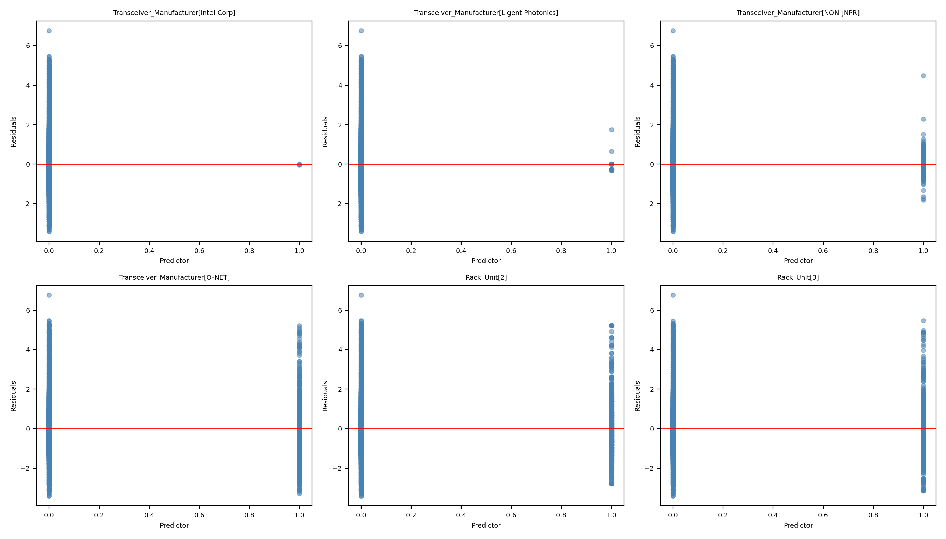
Full Model - Chart 1

Slide 5
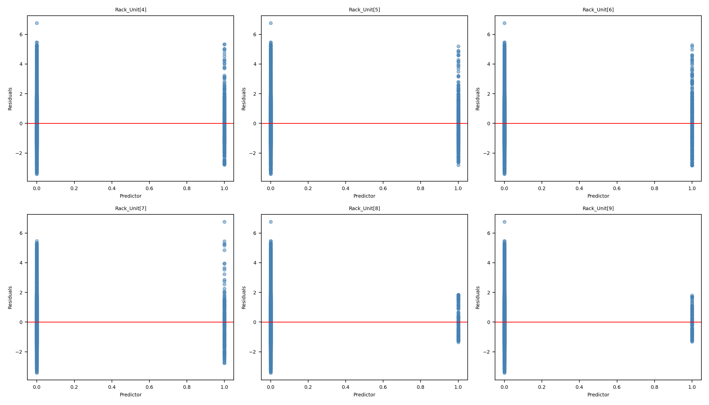
Full Model - Chart 2

Slide 6
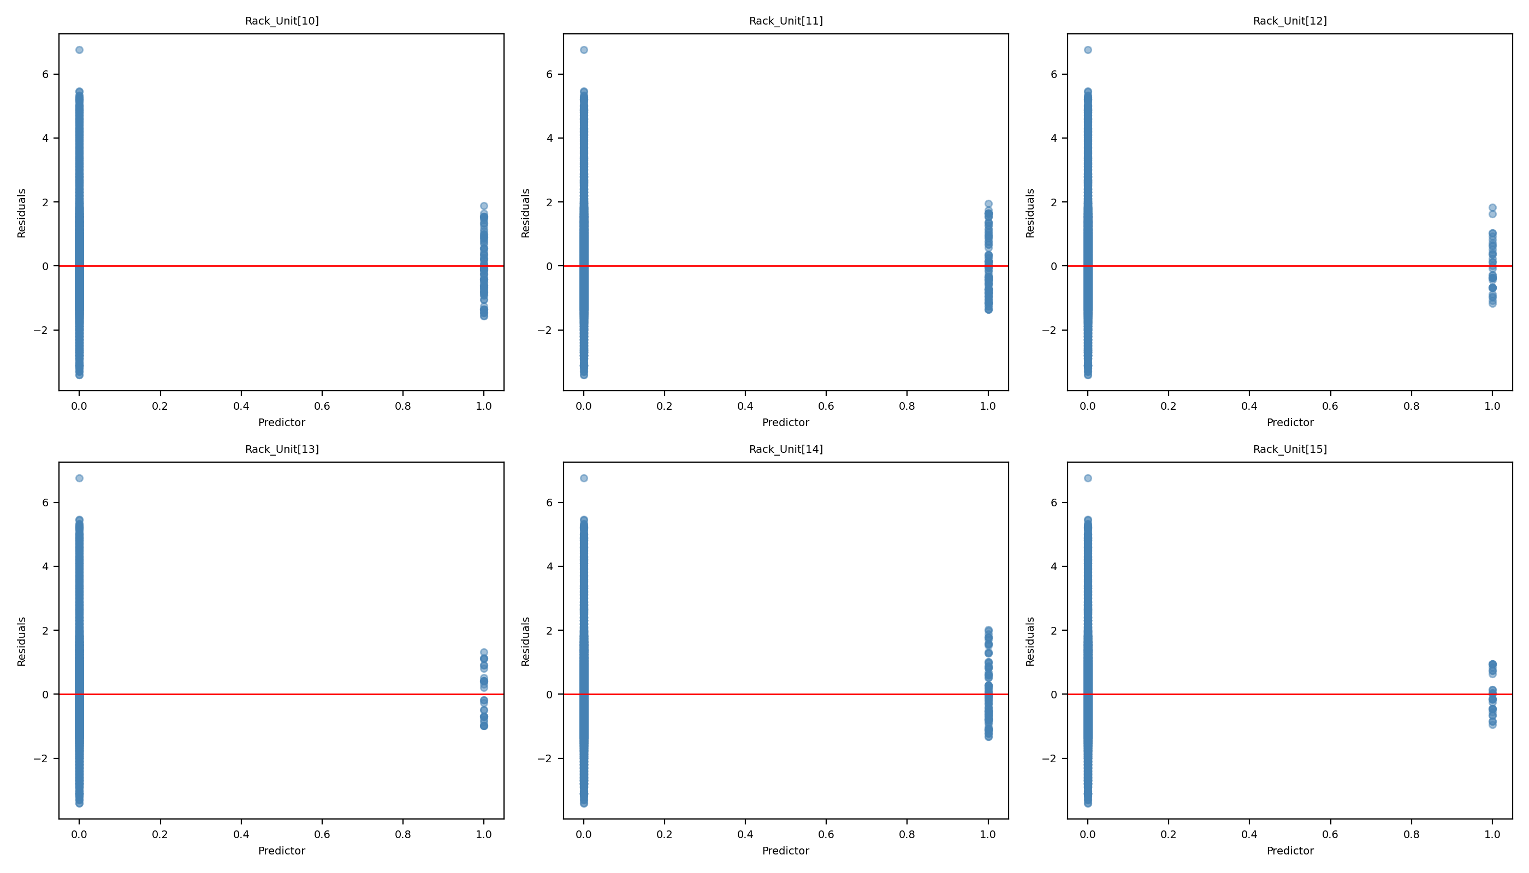
Full Model - Chart 3

Slide 7
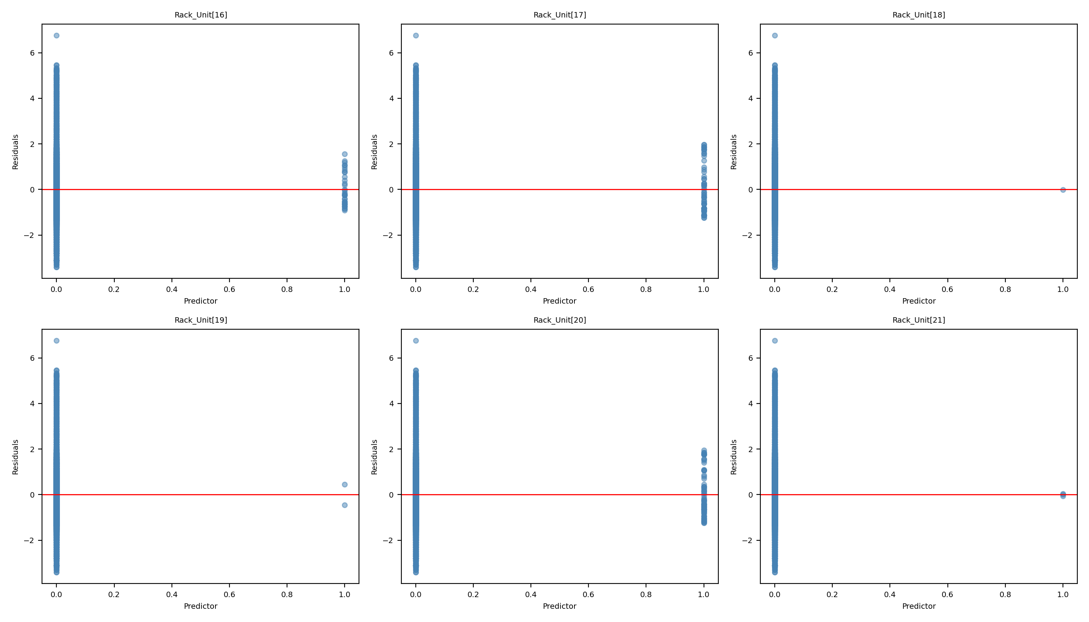
Full Model - Chart 4

Slide 8
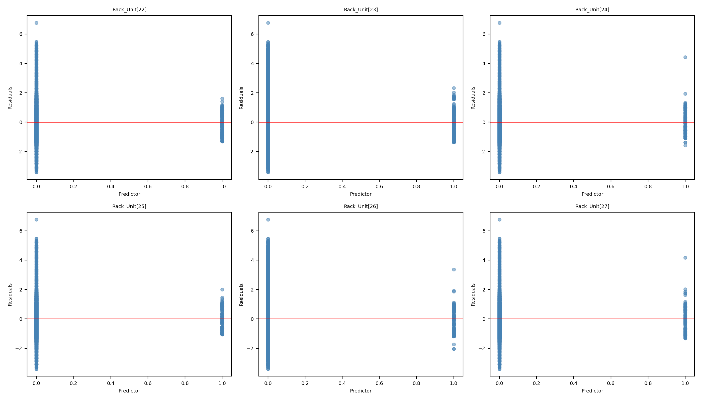
Full Model - Chart 5

Slide 9
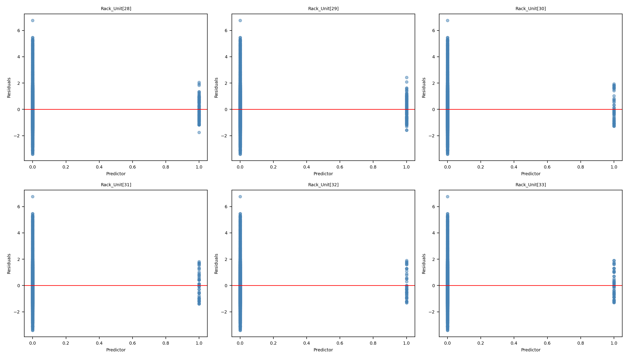
Full Model - Chart 6

Slide 10
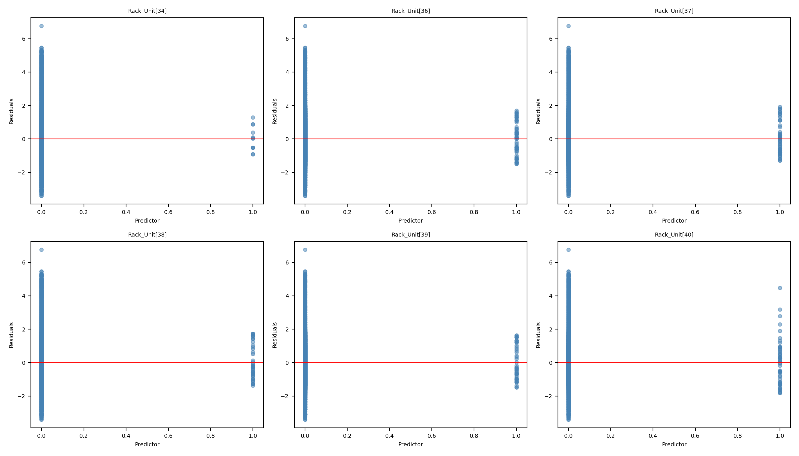
Full Model - Chart 7

Slide 11
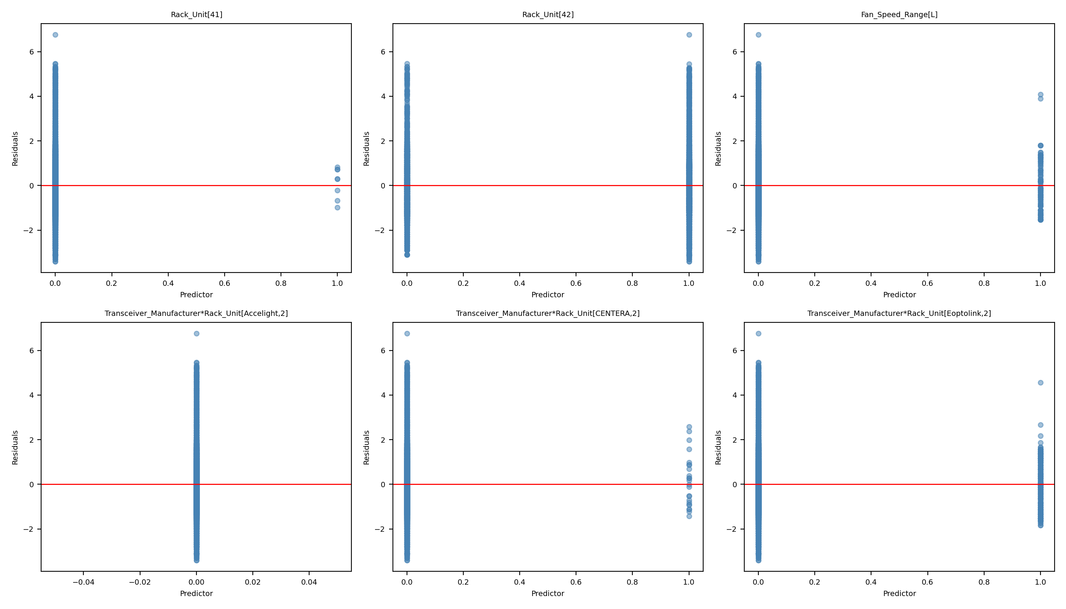
Full Model - Chart 8

Slide 12
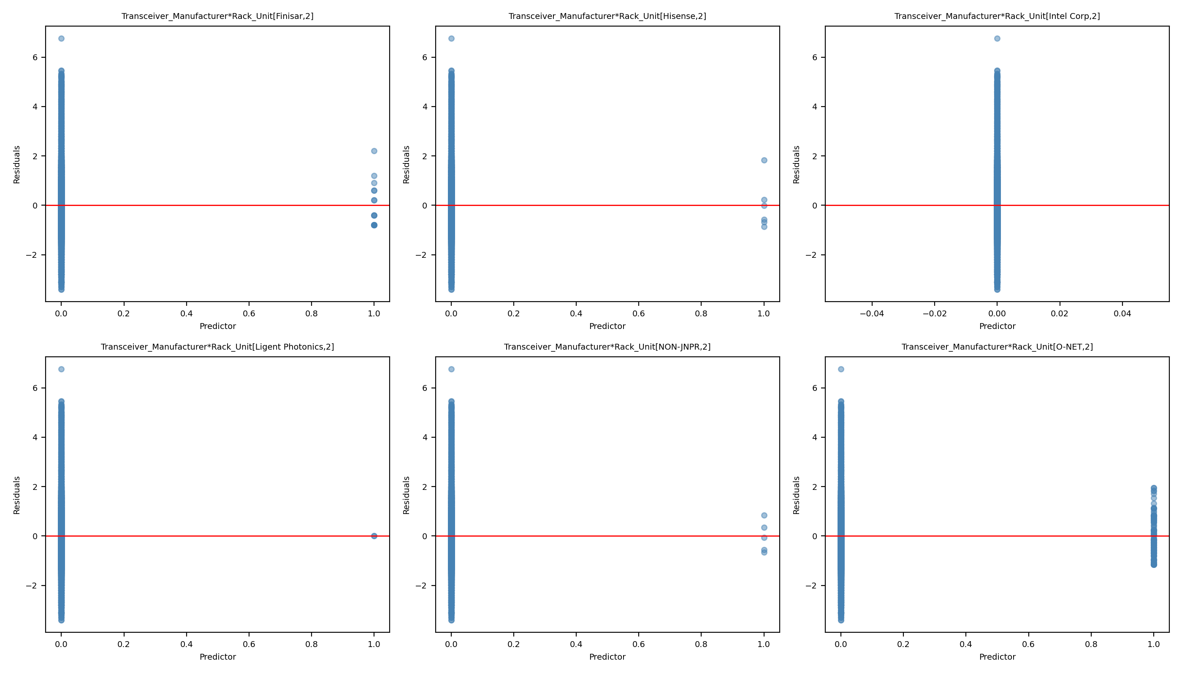
Full Model - Chart 9

Slide 13
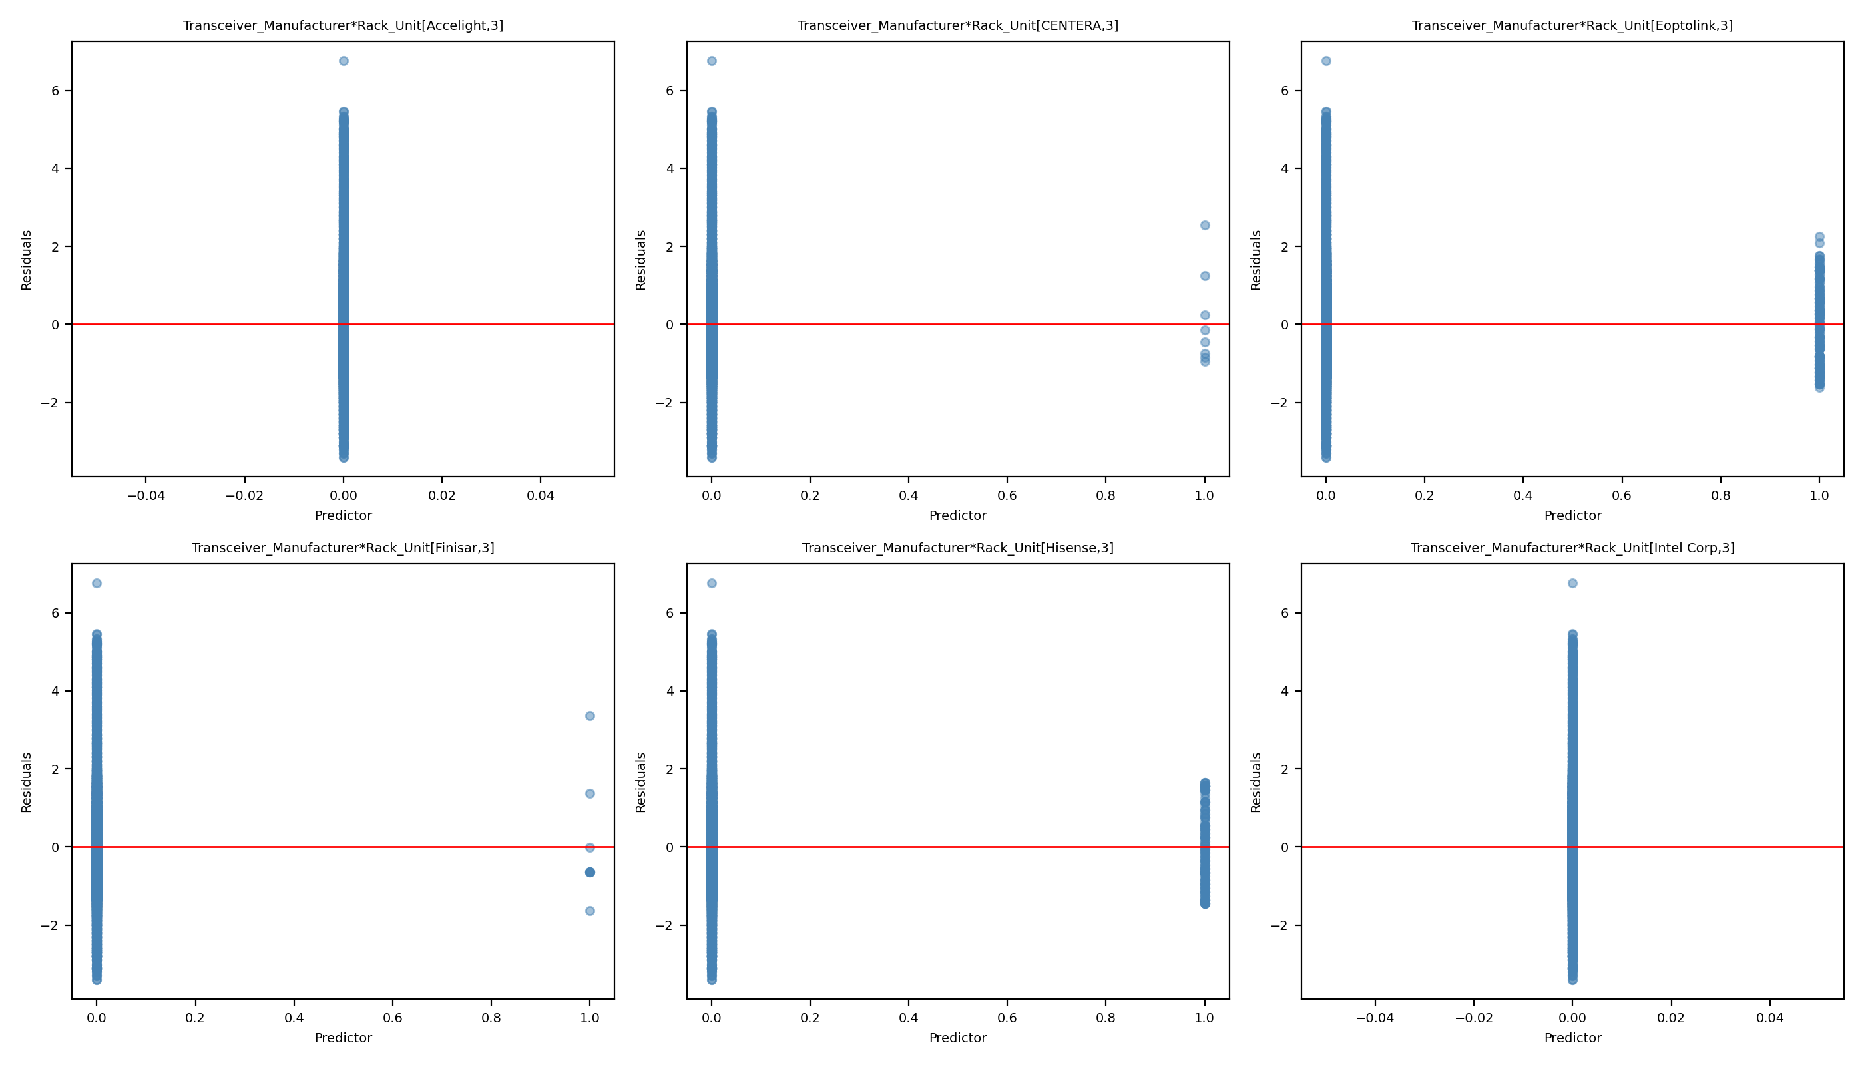
Full Model - Chart 10

Slide 14
Reduced Model Analysis
Streamlined analysis of the 451-parameter reduced model

Slide 15
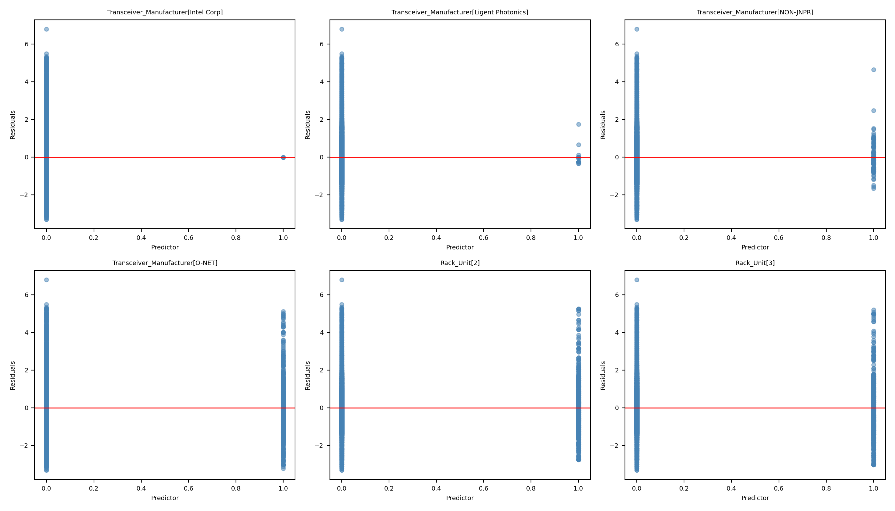
Reduced Model - Chart 1

Slide 16
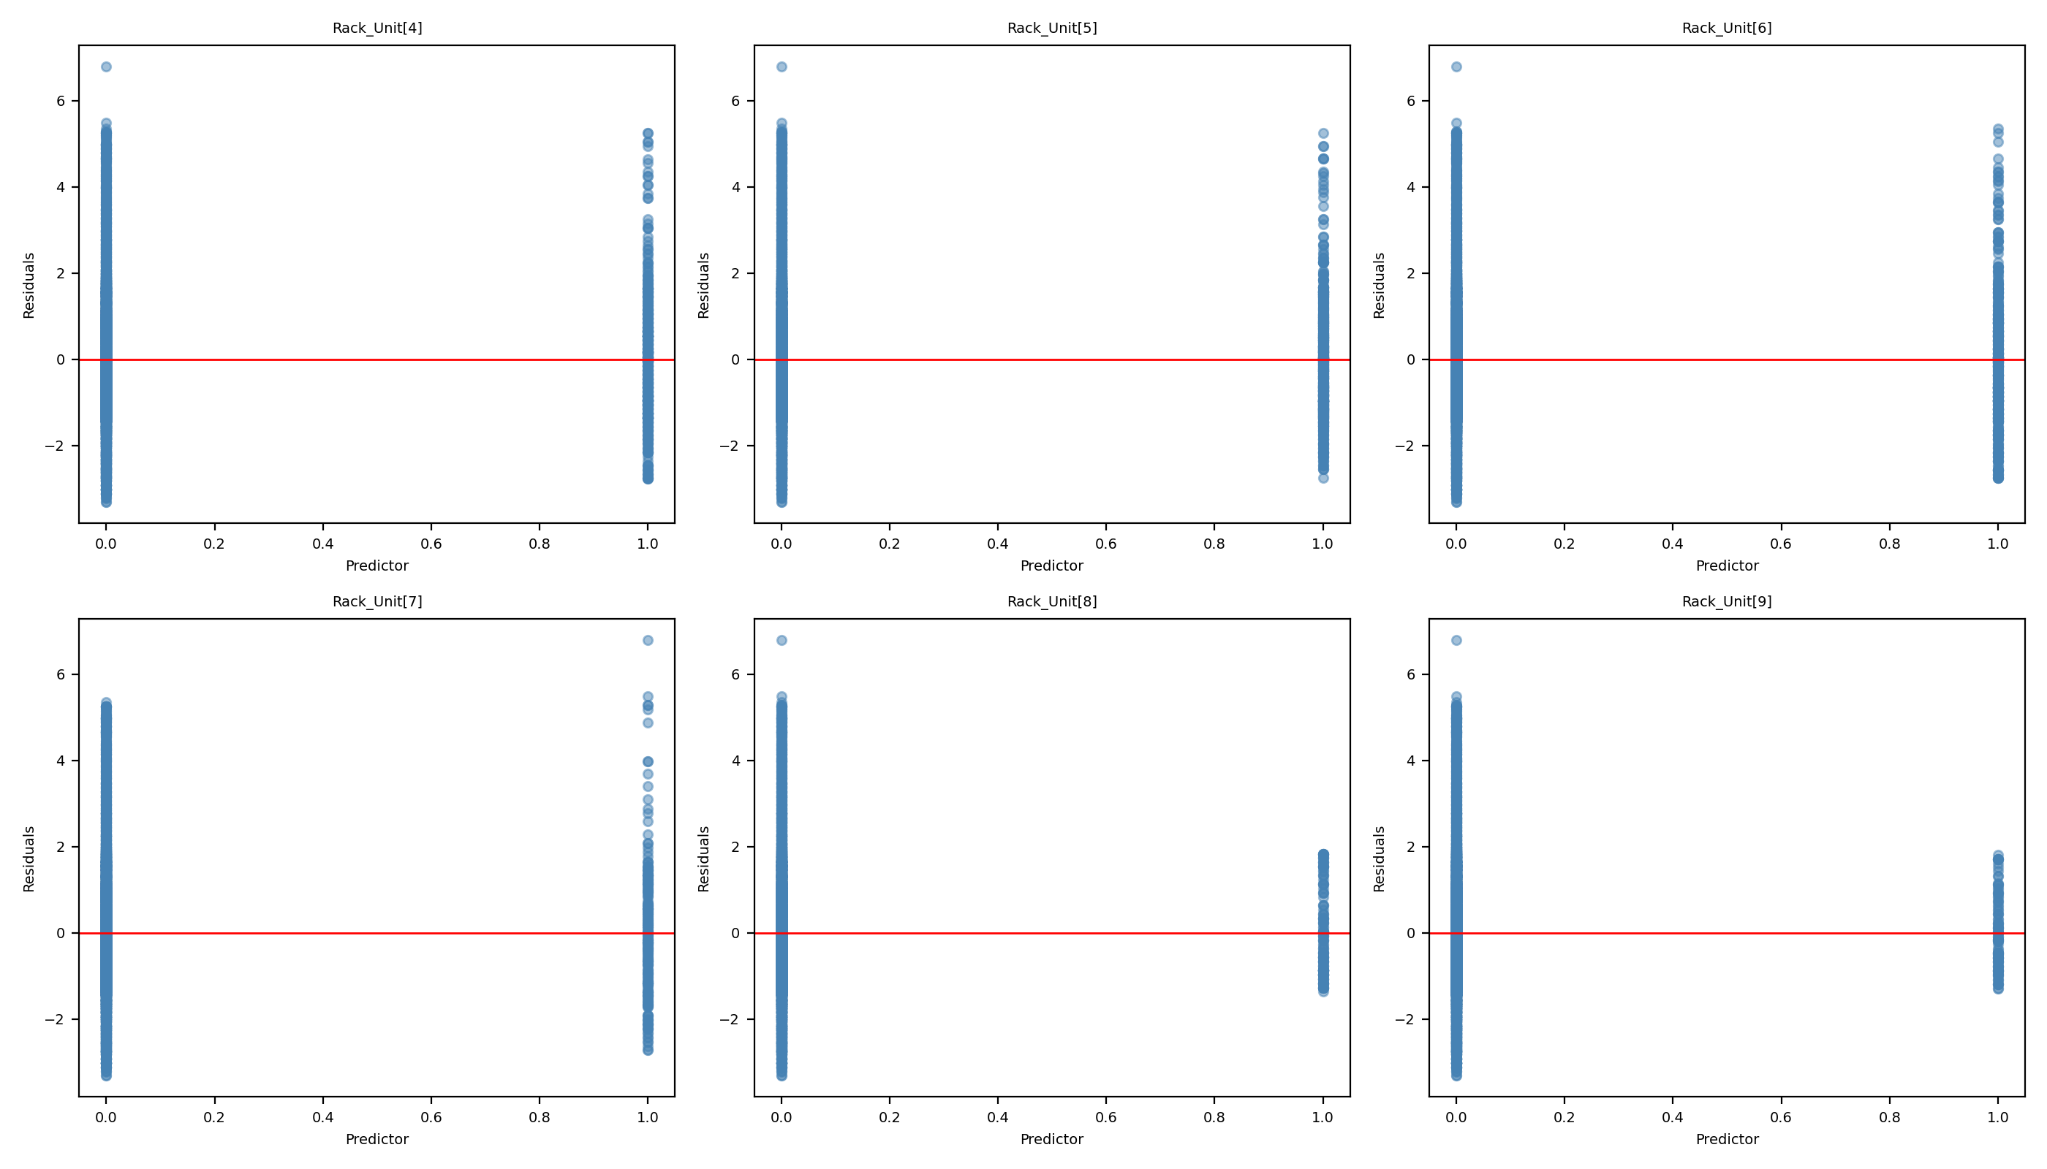
Reduced Model - Chart 2

Slide 17
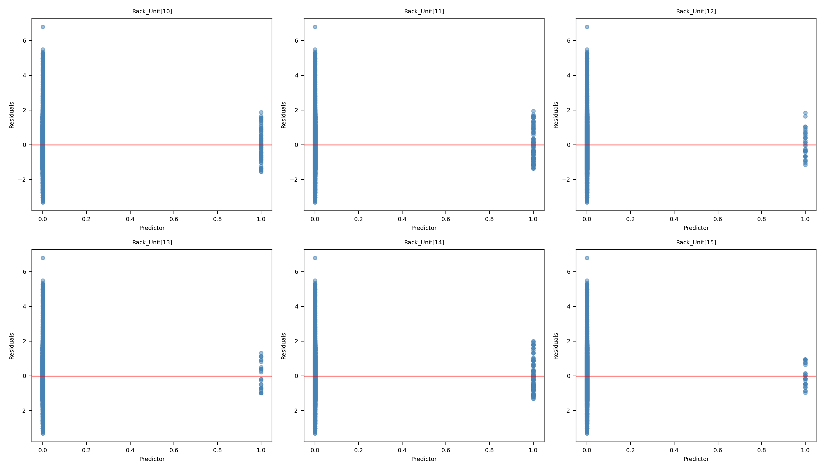
Reduced Model - Chart 3

Slide 18
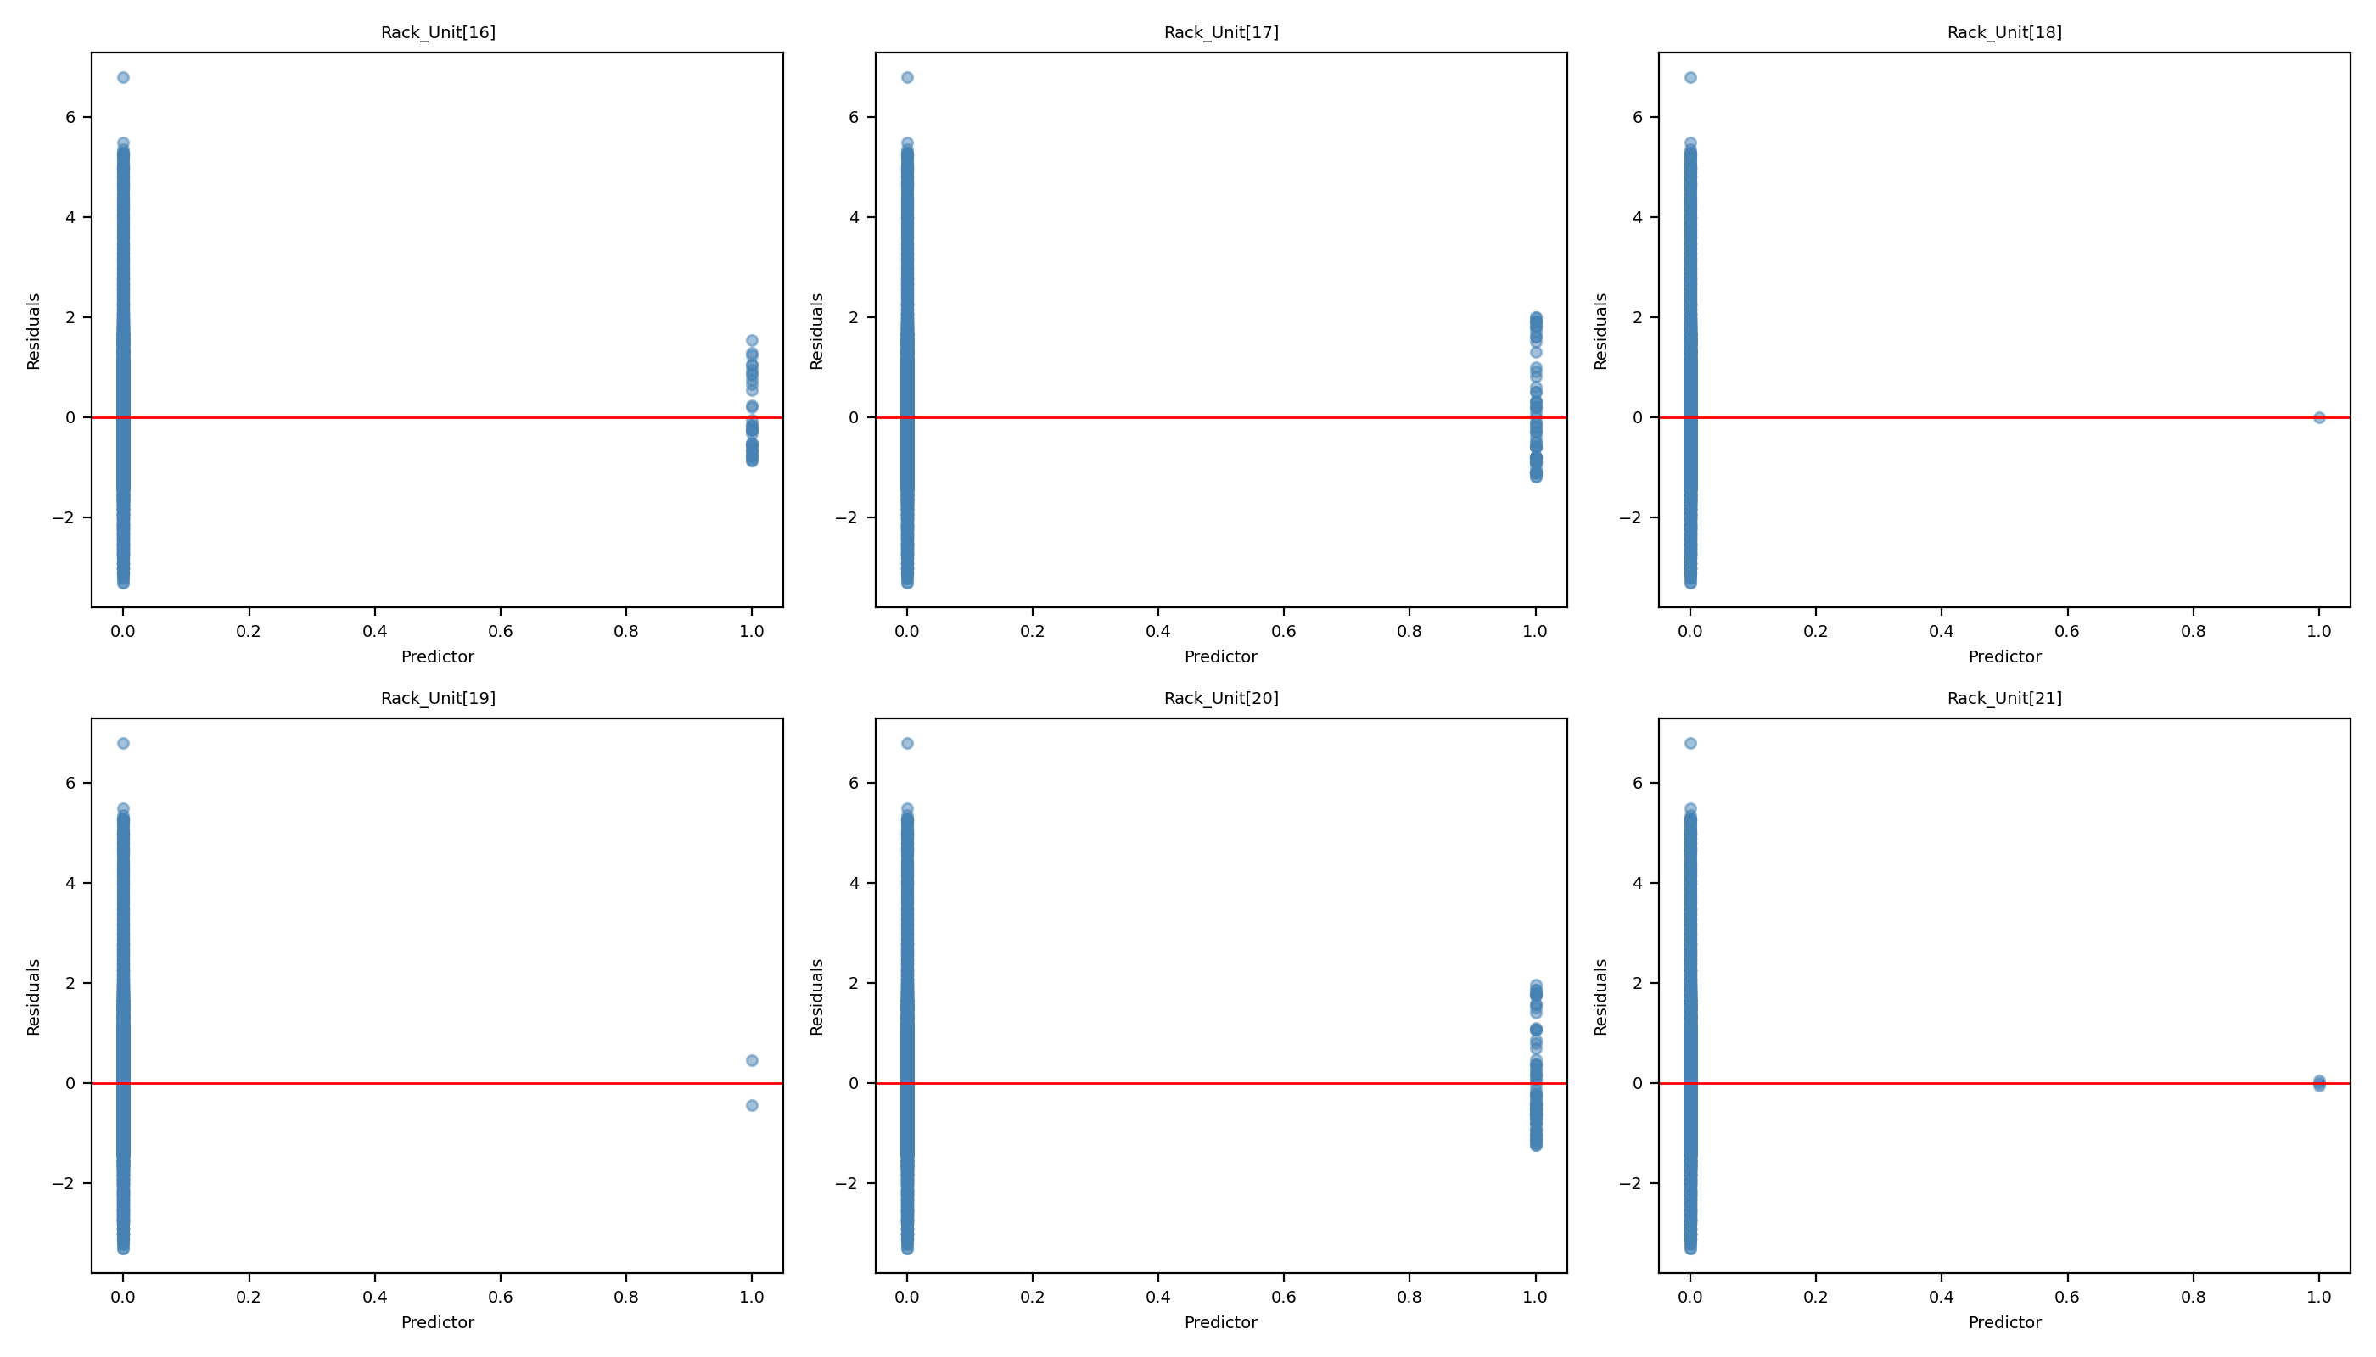
Reduced Model - Chart 4

Slide 19
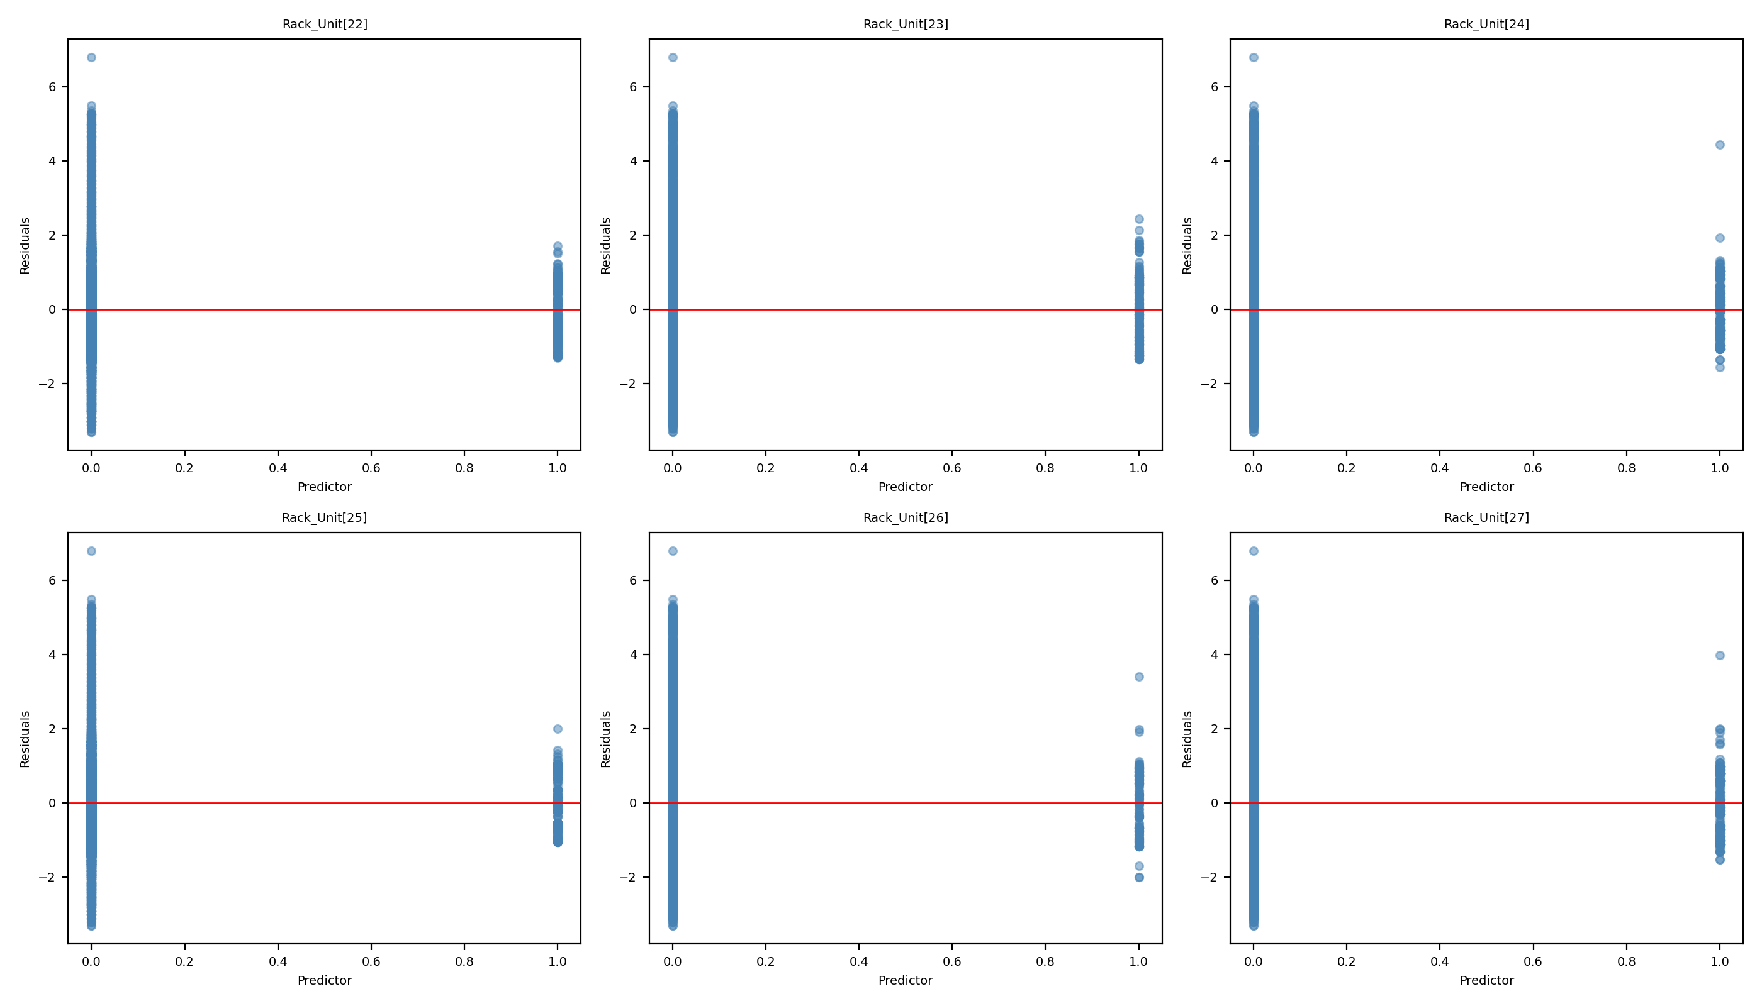
Reduced Model - Chart 5

Slide 20
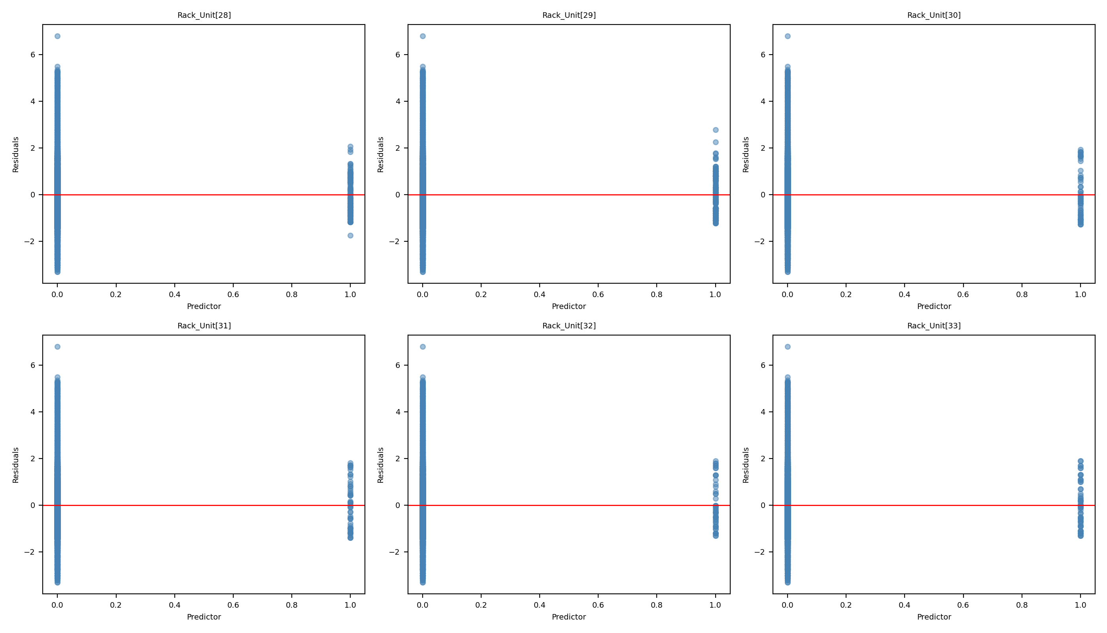
Reduced Model - Chart 6

Slide 21
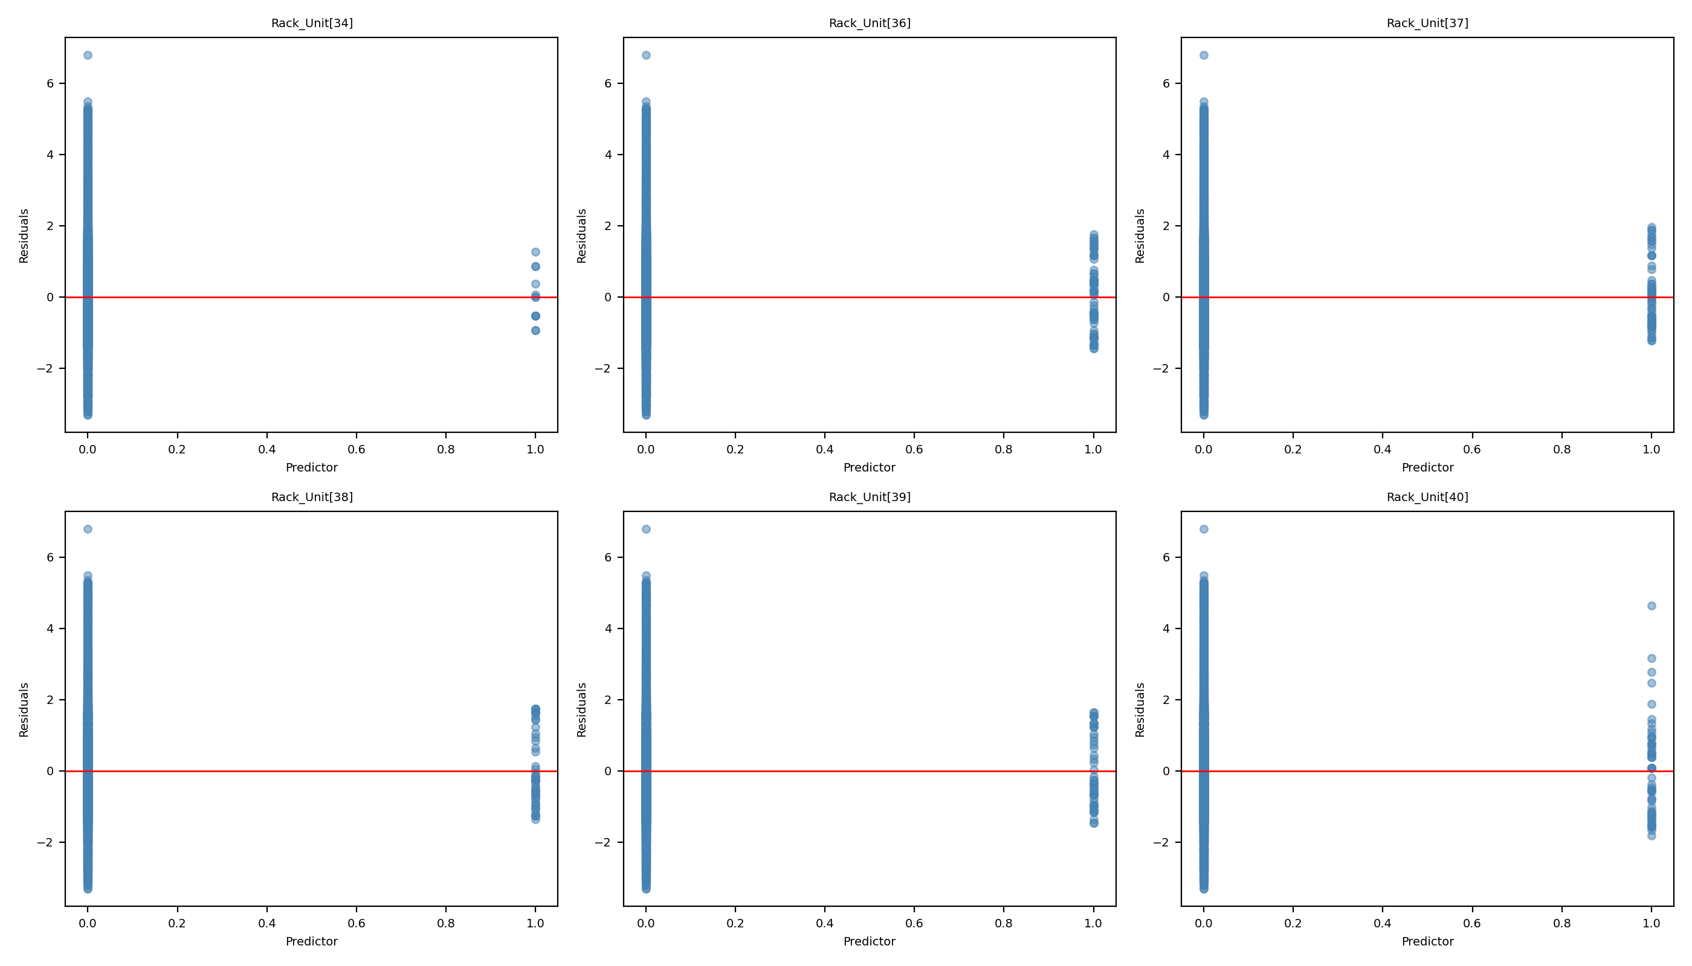
Reduced Model - Chart 7

Slide 22
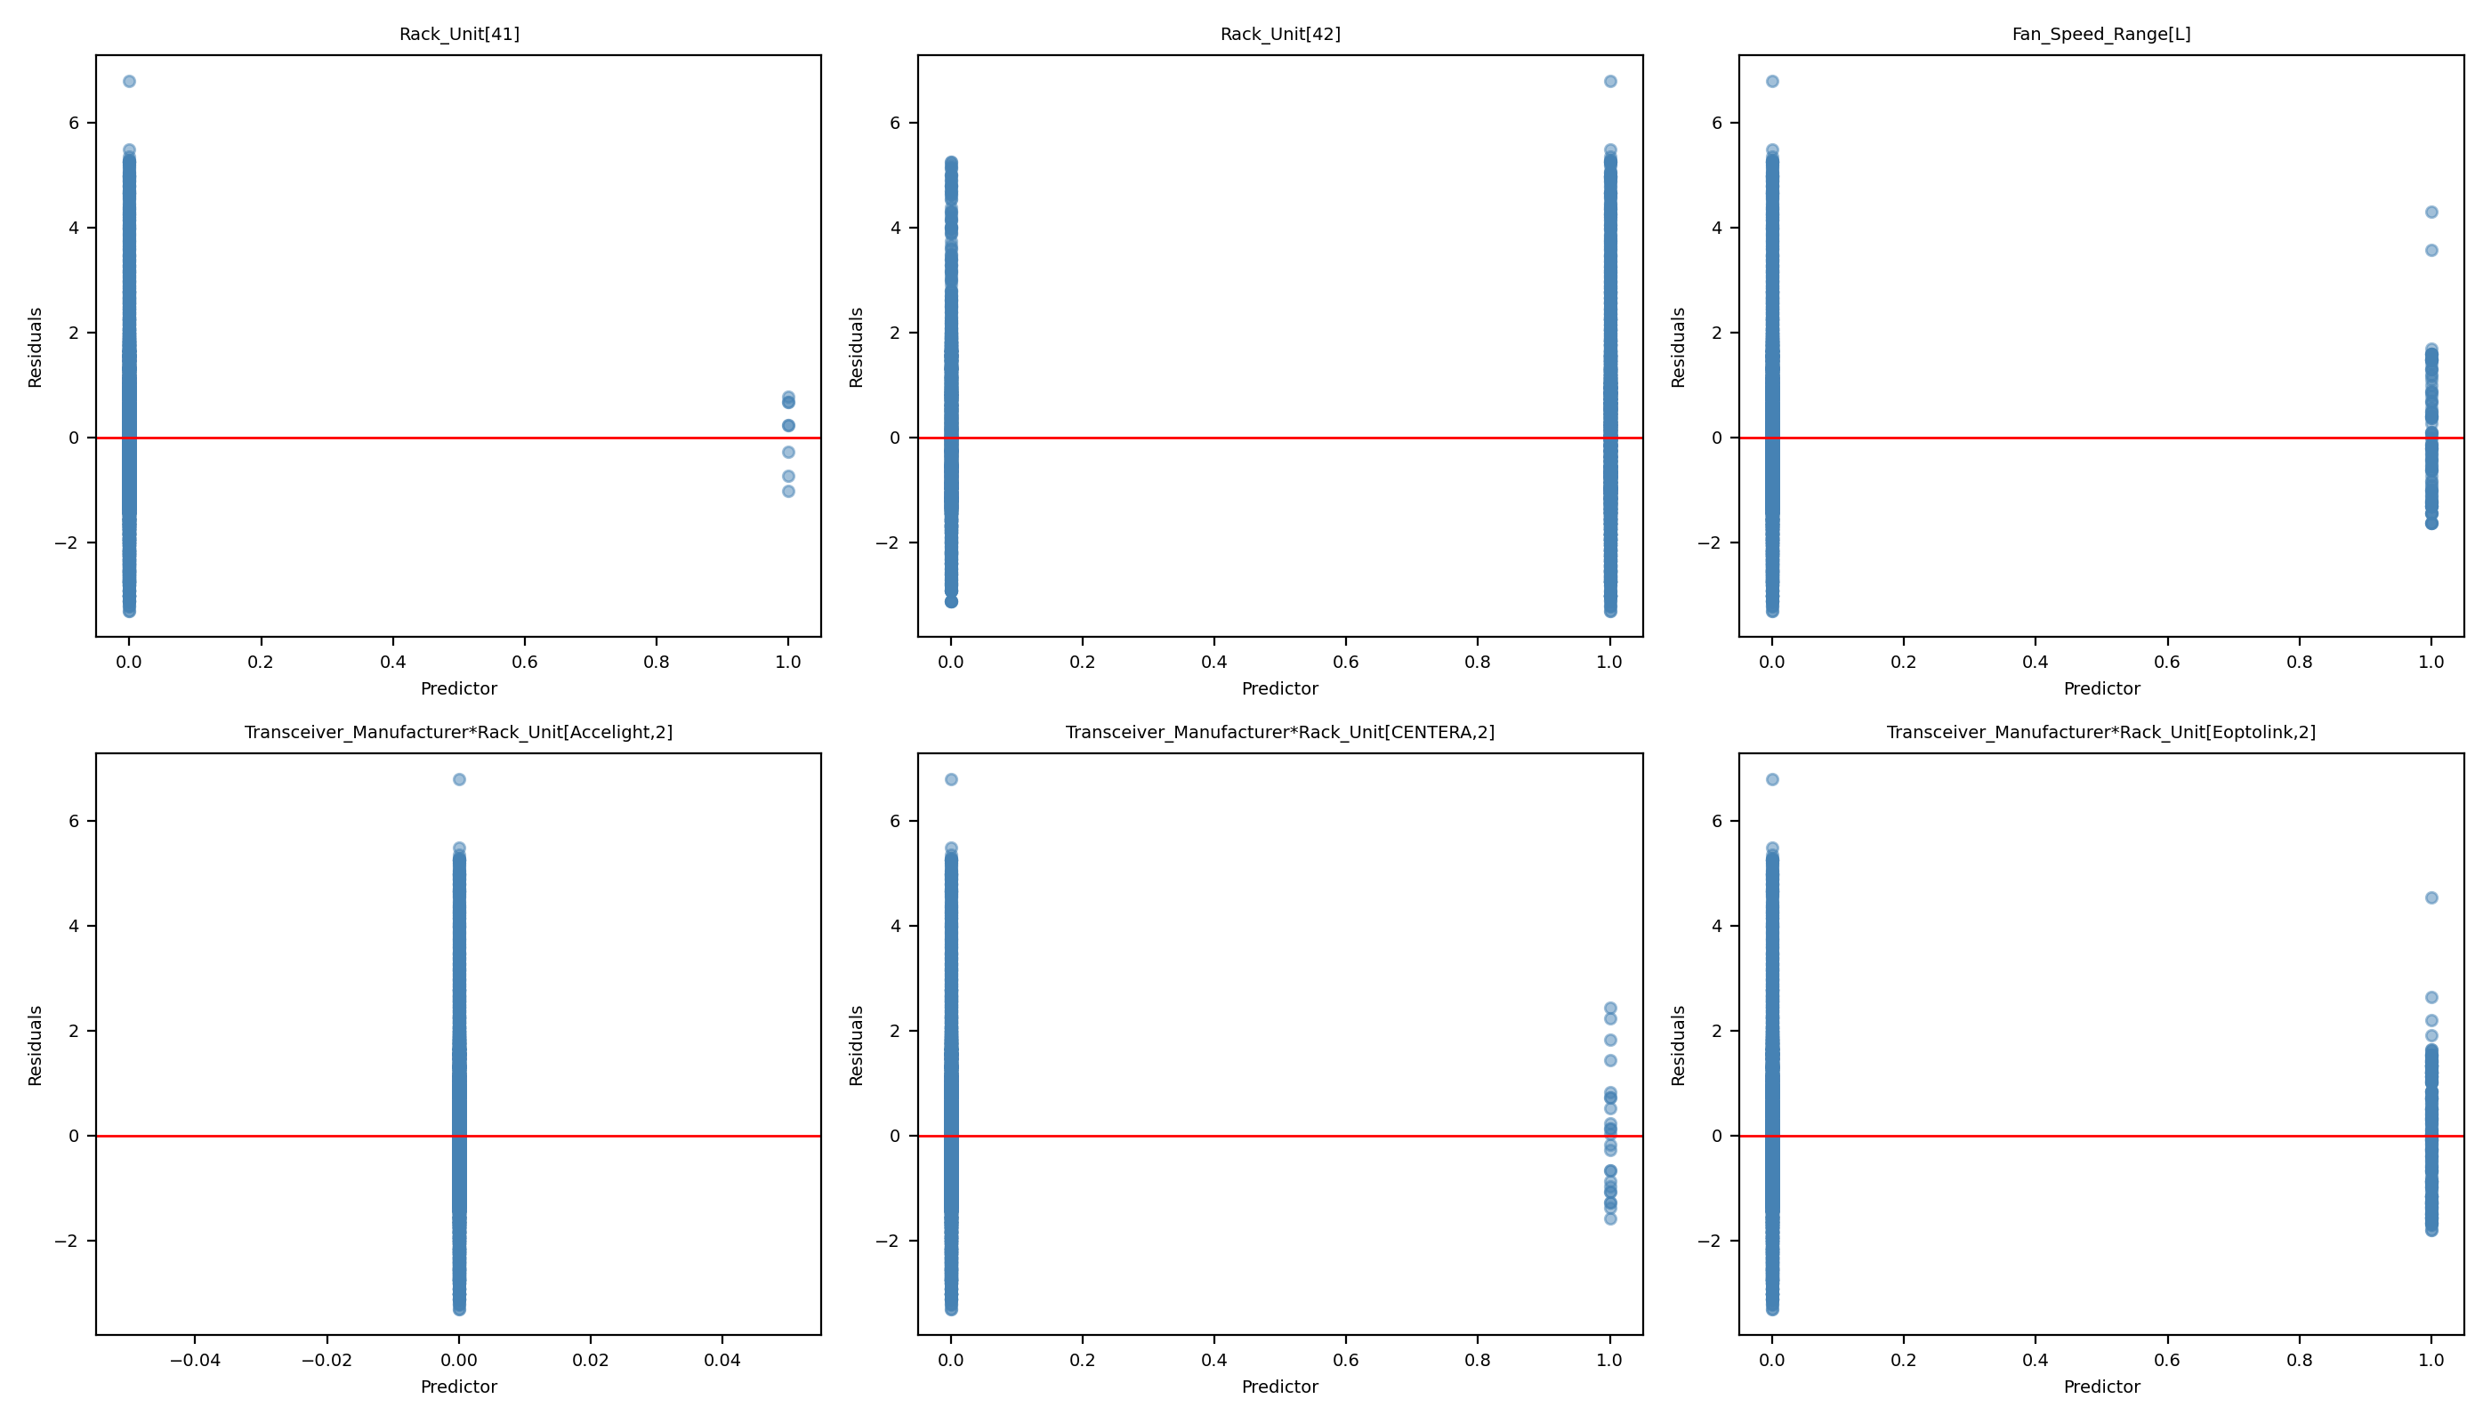
Reduced Model - Chart 8

Slide 23
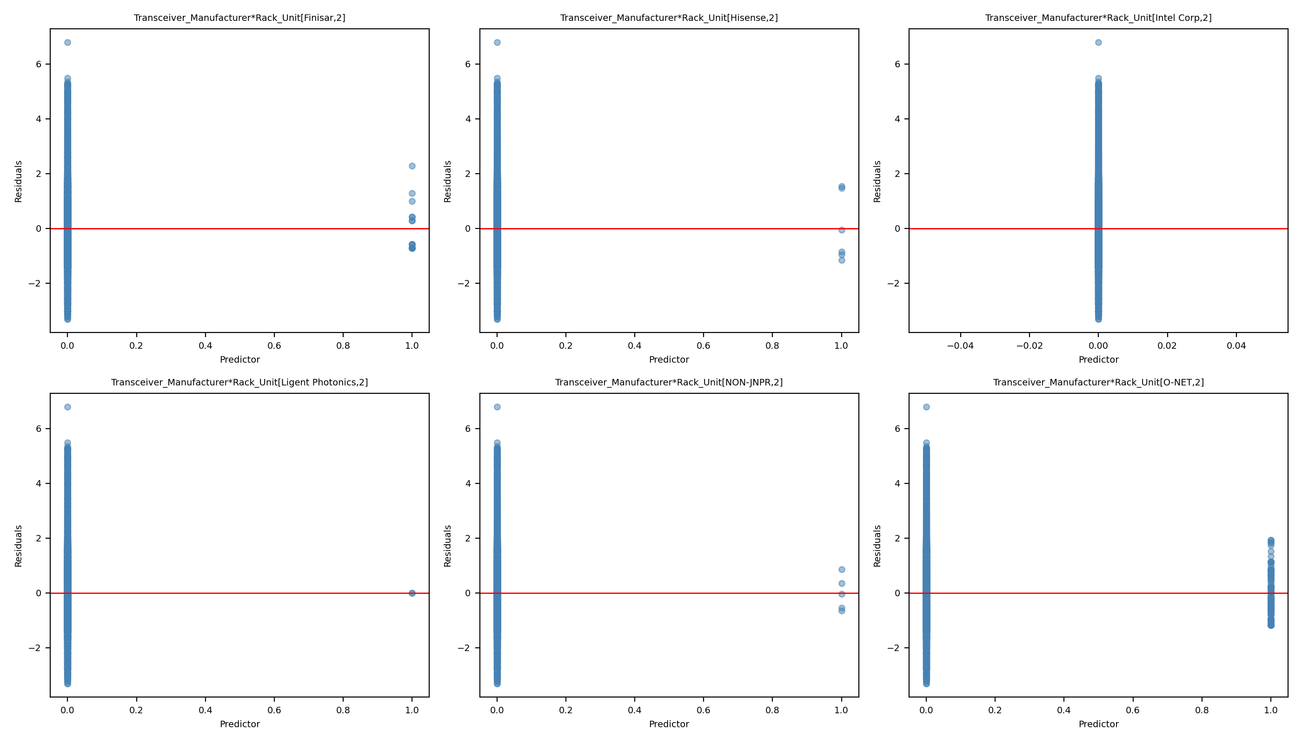
Reduced Model - Chart 9

Slide 24
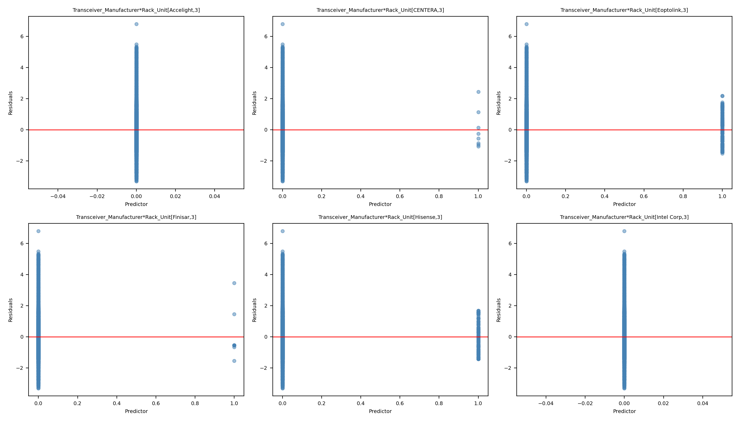
Reduced Model - Chart 10

Slide 25
Leverage Plot Comparisons
Side-by-side comparison of leverage plots from full and reduced models

Slide 26
Leverage Comparison 1: Full Model vs Reduced Model
Full Model
Reduced Model

Slide 27
Leverage Comparison 2: Full Model vs Reduced Model
Full Model
Reduced Model

Slide 28
Leverage Comparison 3: Full Model vs Reduced Model
Full Model
Reduced Model

Slide 29
Leverage Comparison 4: Full Model vs Reduced Model
Full Model
Reduced Model

Slide 30
Leverage Comparison 5: Full Model vs Reduced Model
Full Model
Reduced Model

Slide 31
Leverage Comparison 6: Full Model vs Reduced Model
Full Model
Reduced Model

Slide 32
Leverage Comparison 7: Full Model vs Reduced Model
Full Model
Reduced Model

Slide 33
Leverage Comparison 8: Full Model vs Reduced Model
Full Model
Reduced Model

Slide 34
Leverage Comparison 9: Full Model vs Reduced Model
Full Model
Reduced Model

Slide 35
Leverage Comparison 10: Full Model vs Reduced Model
Full Model
Reduced Model

Slide 36
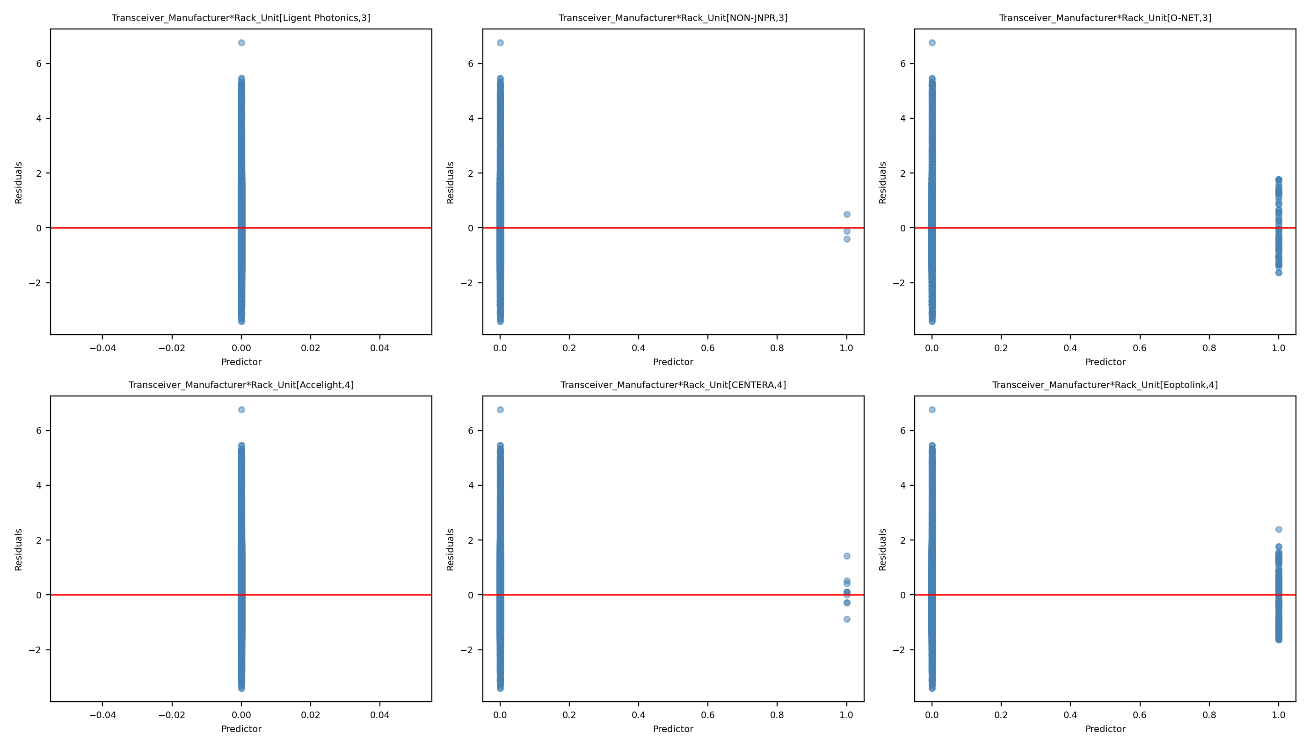
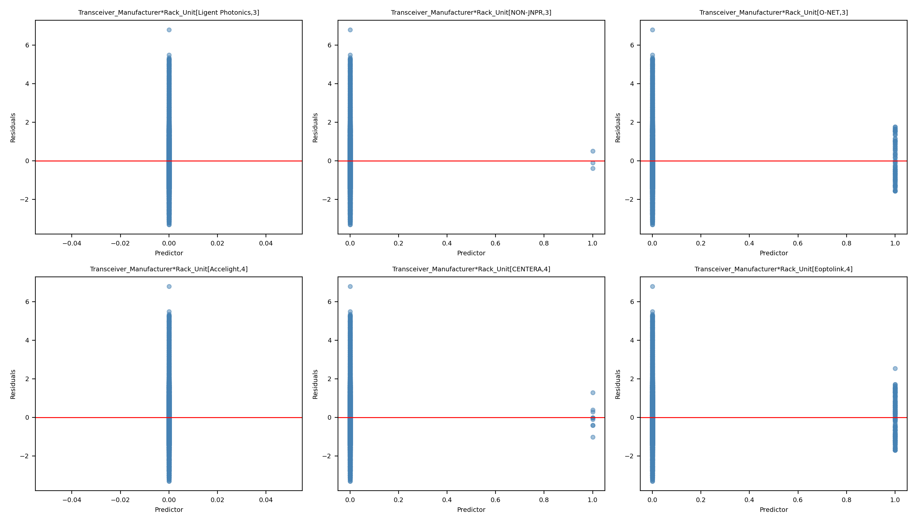
Leverage Comparison 11: Full Model vs Reduced Model
Full Model
Reduced Model

Slide 37
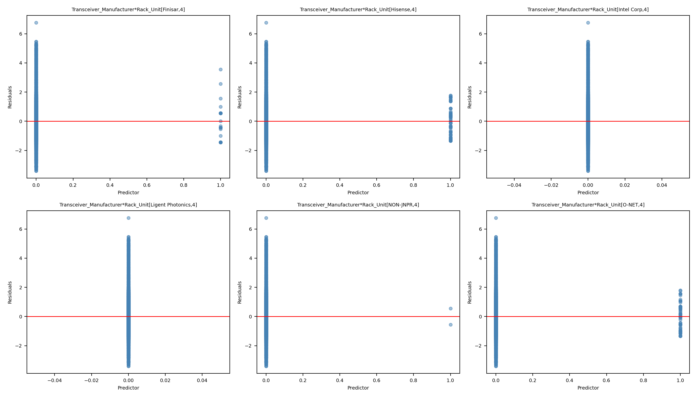
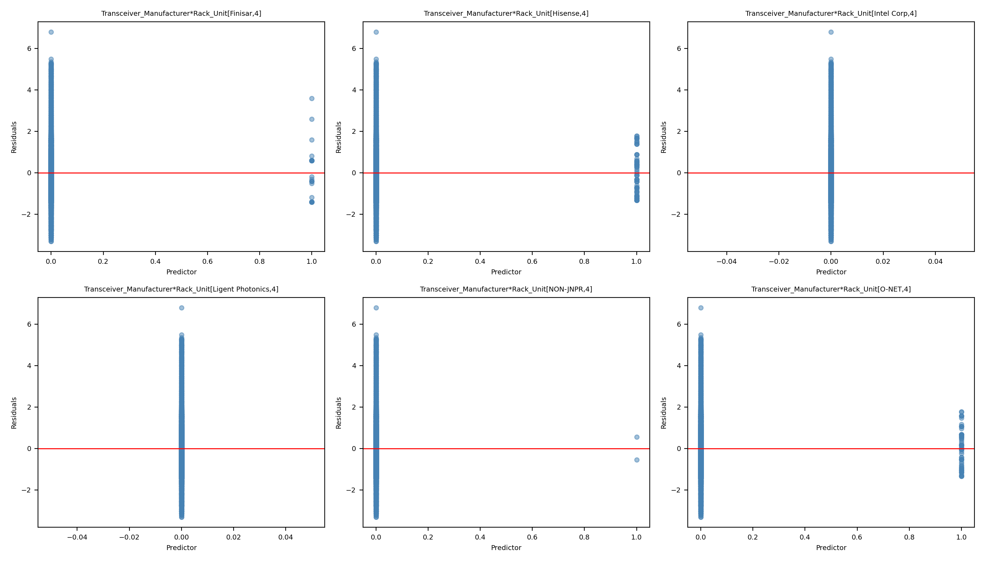
Leverage Comparison 12: Full Model vs Reduced Model
Full Model
Reduced Model

Slide 38
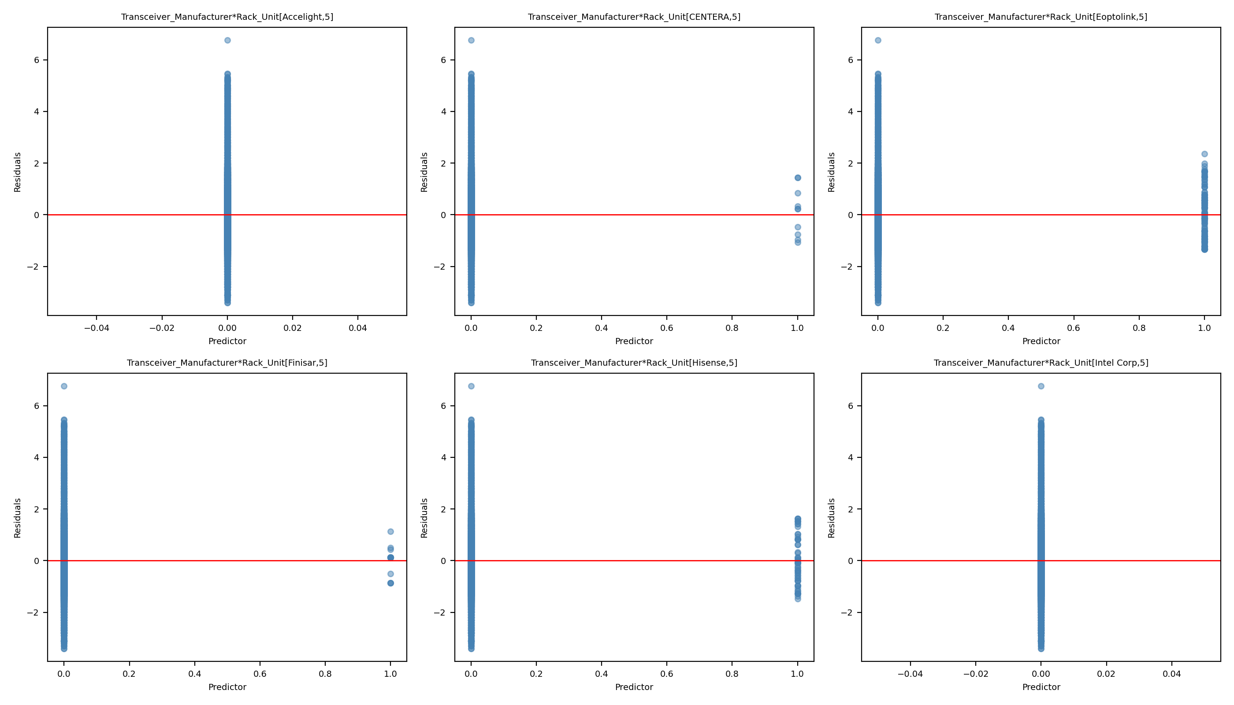
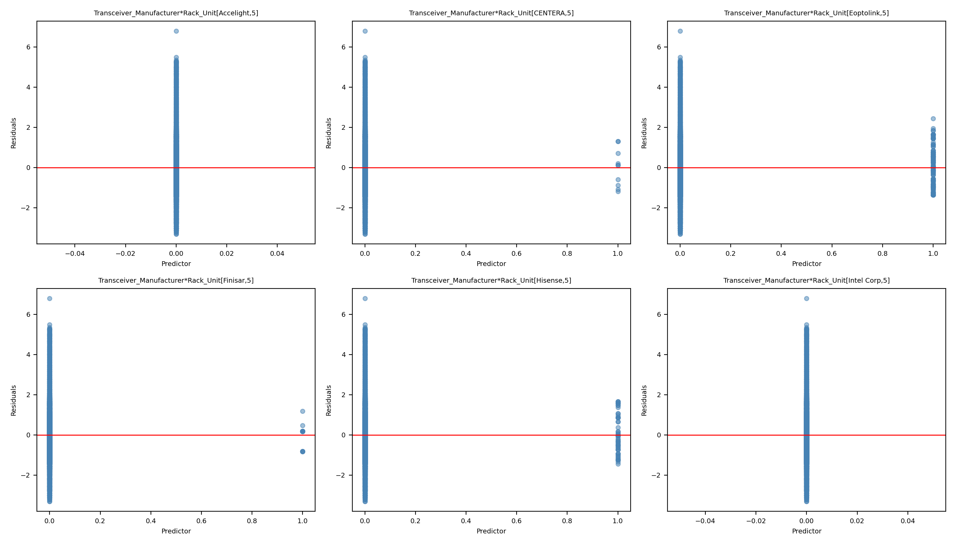
Leverage Comparison 13: Full Model vs Reduced Model
Full Model
Reduced Model

Slide 39
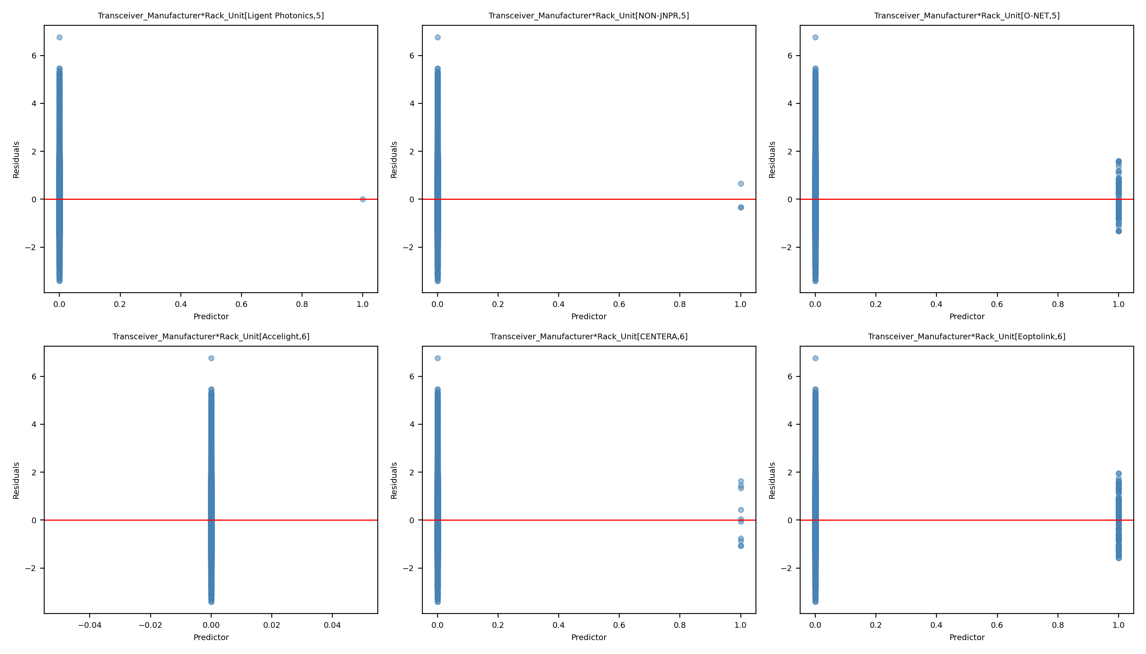

Leverage Comparison 14: Full Model vs Reduced Model
Full Model
Reduced Model

Slide 40
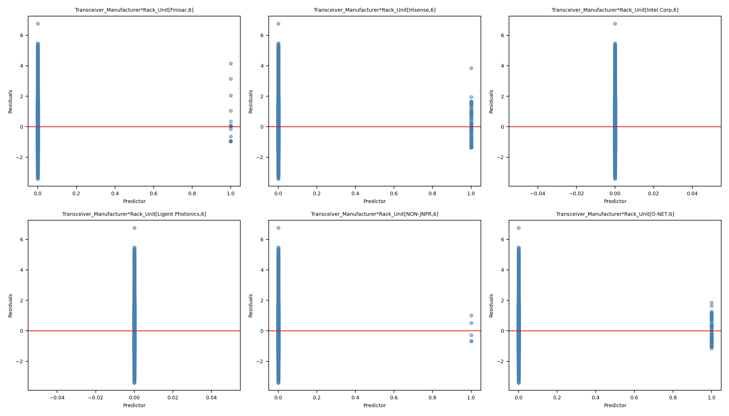

Leverage Comparison 15: Full Model vs Reduced Model
Full Model
Reduced Model

Slide 41
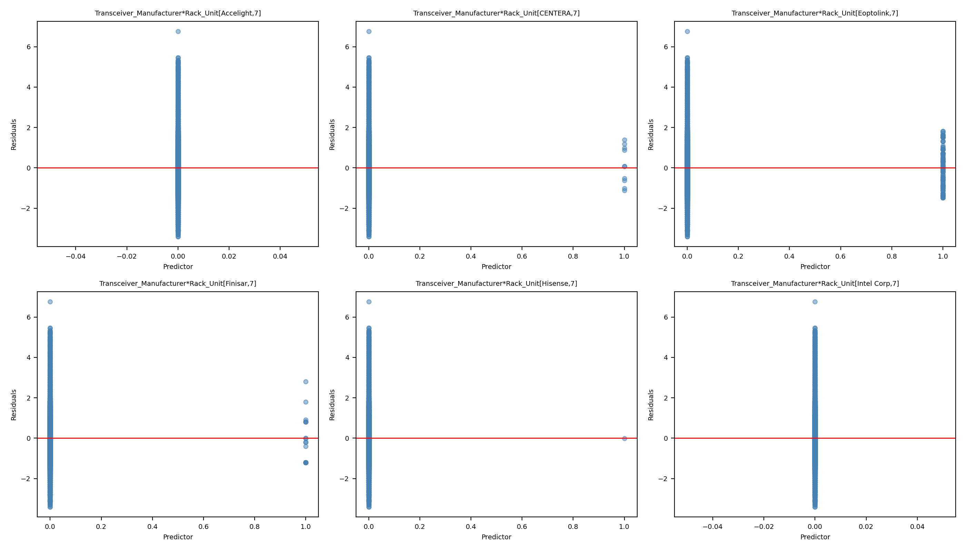
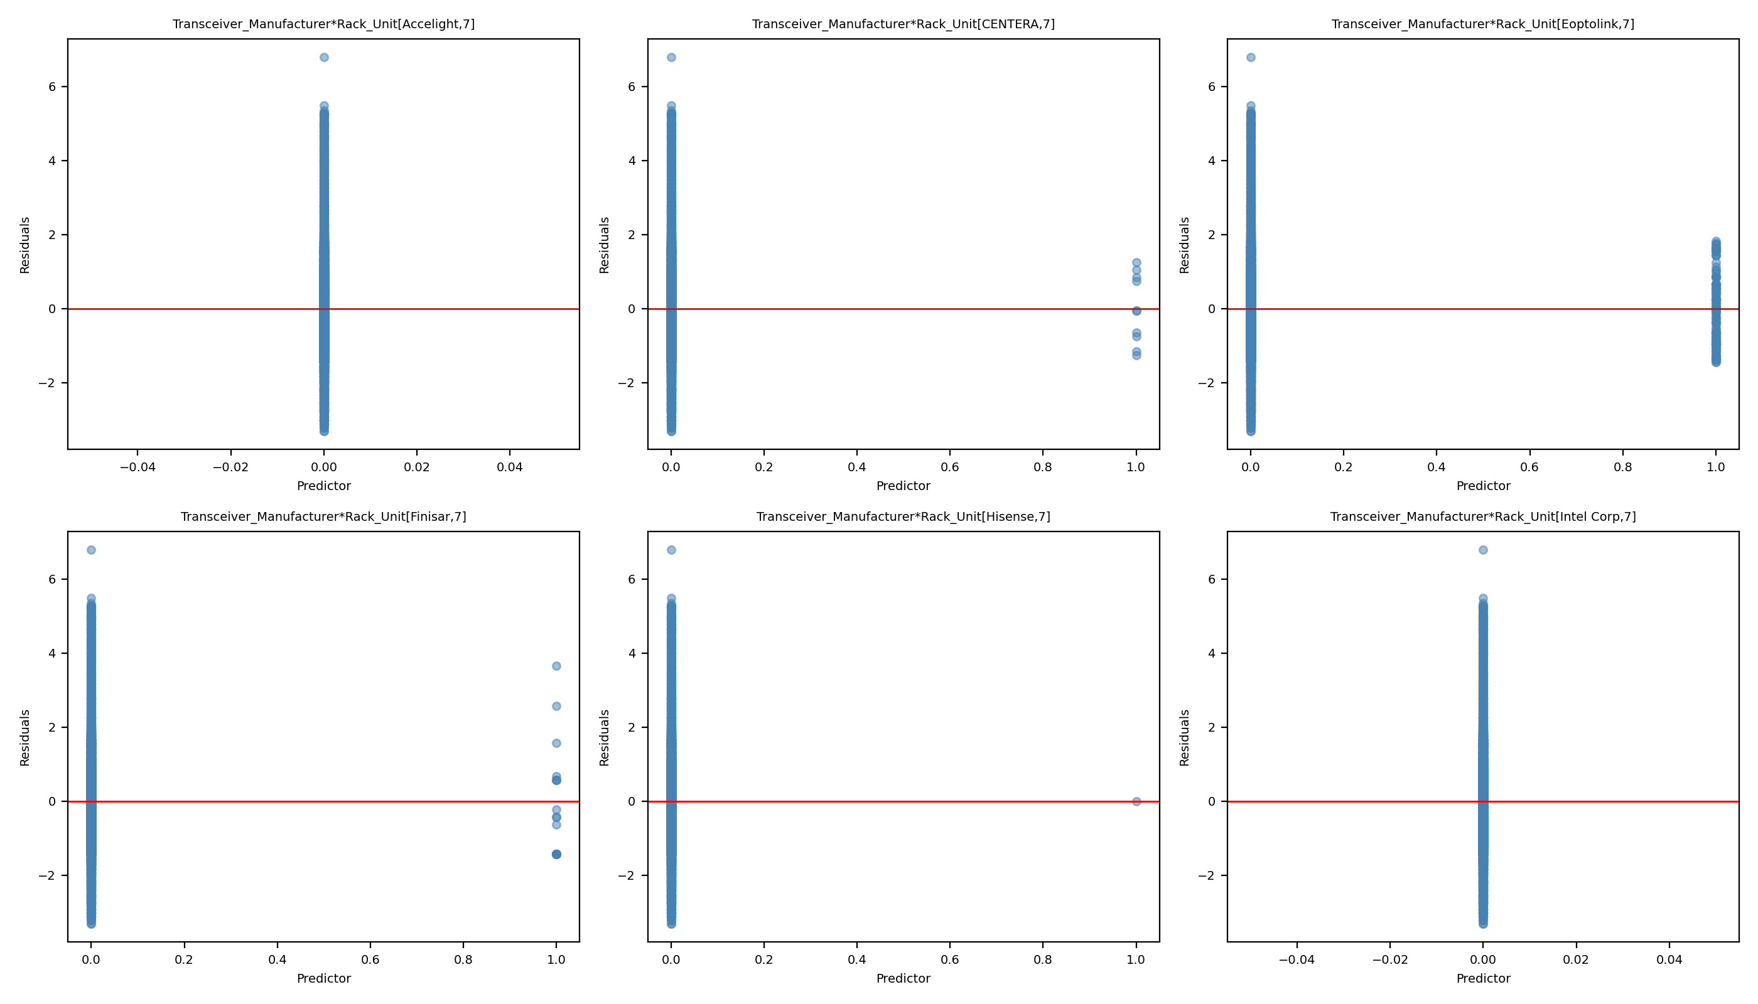
Leverage Comparison 16: Full Model vs Reduced Model
Full Model
Reduced Model

Slide 42
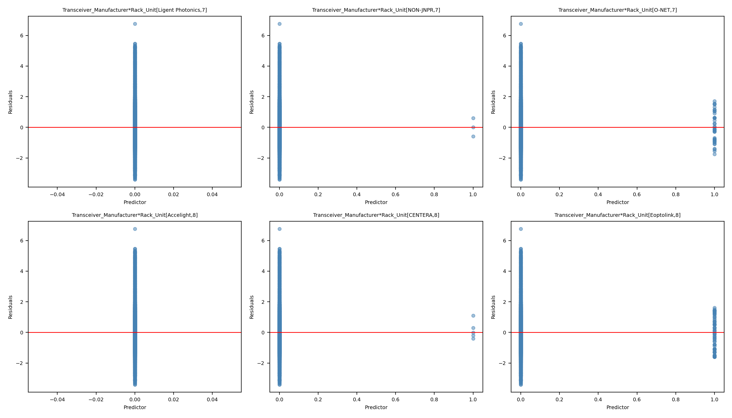
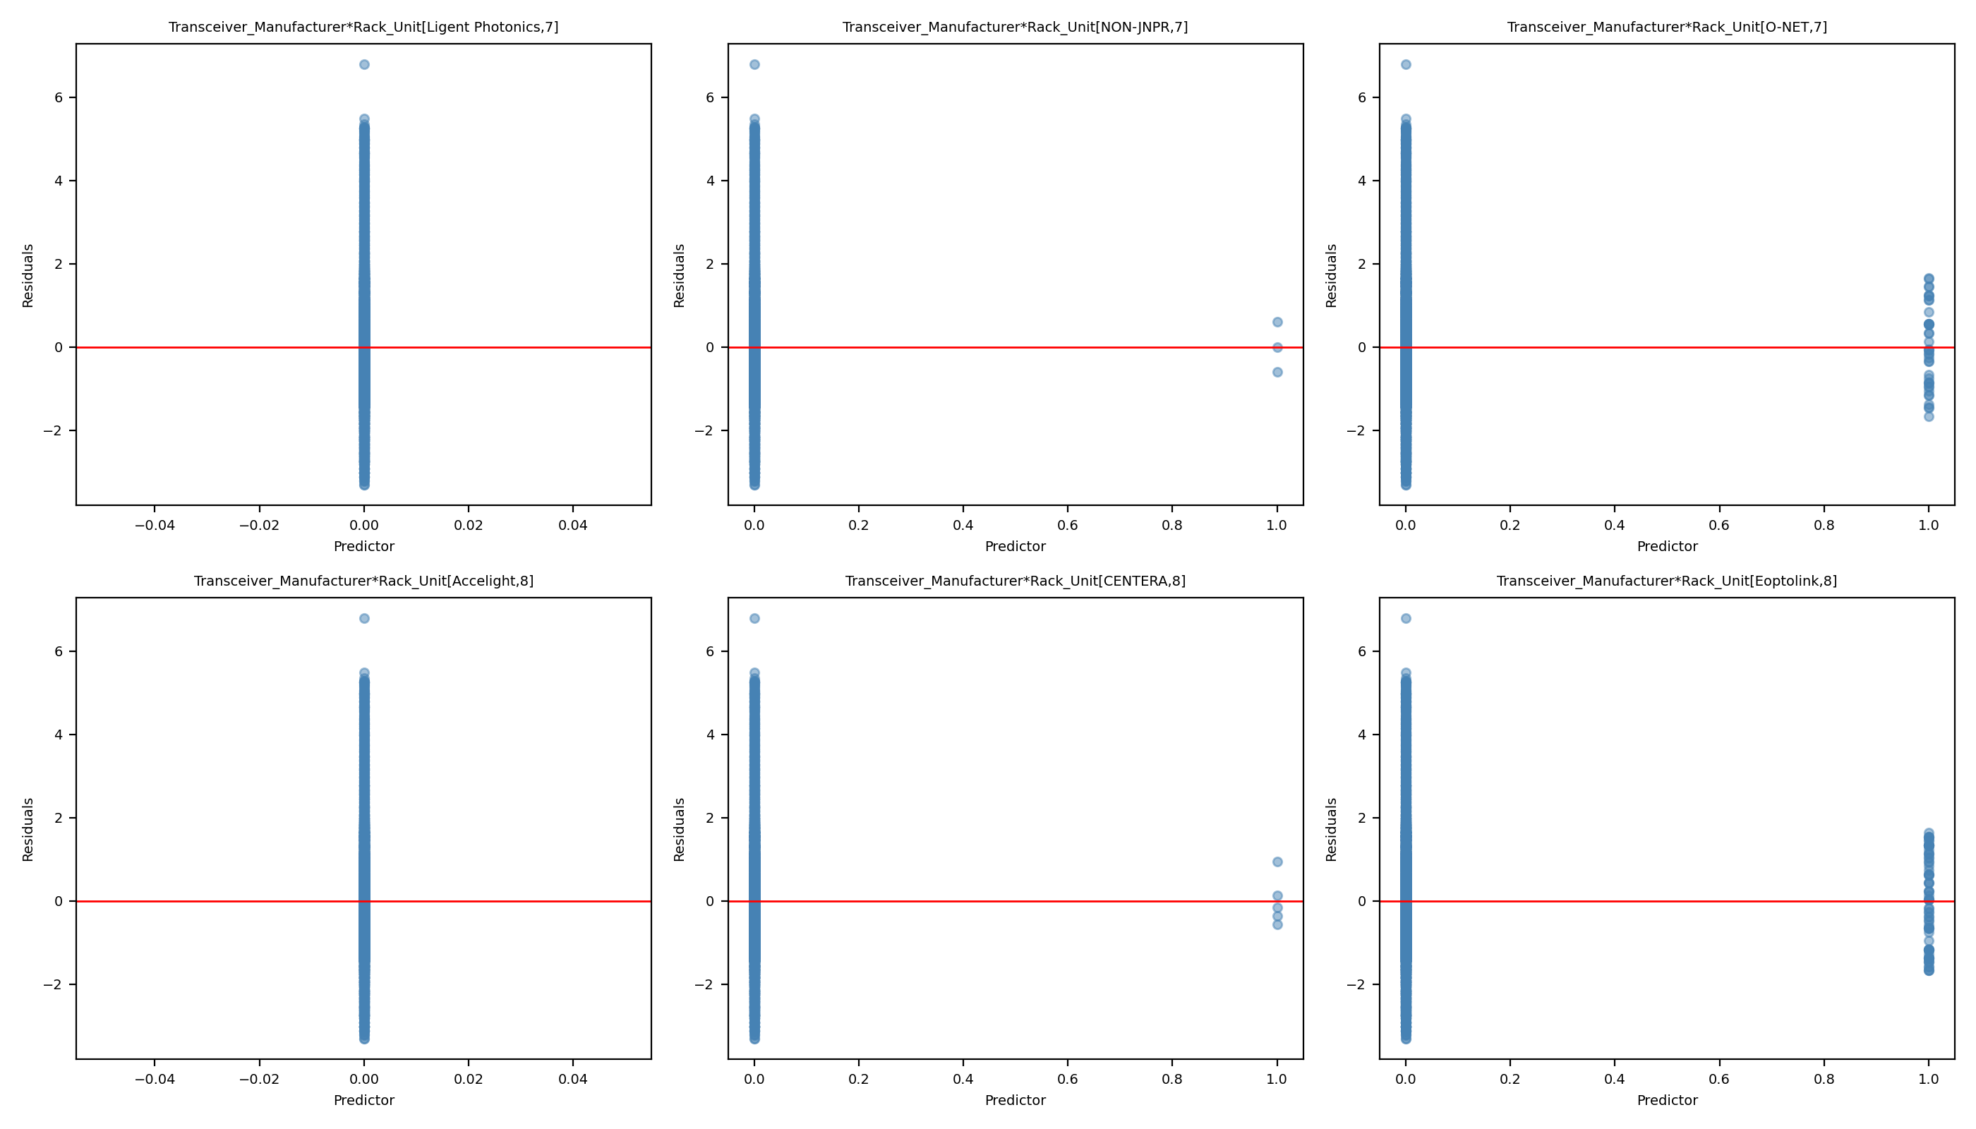
Leverage Comparison 17: Full Model vs Reduced Model
Full Model
Reduced Model

Slide 43
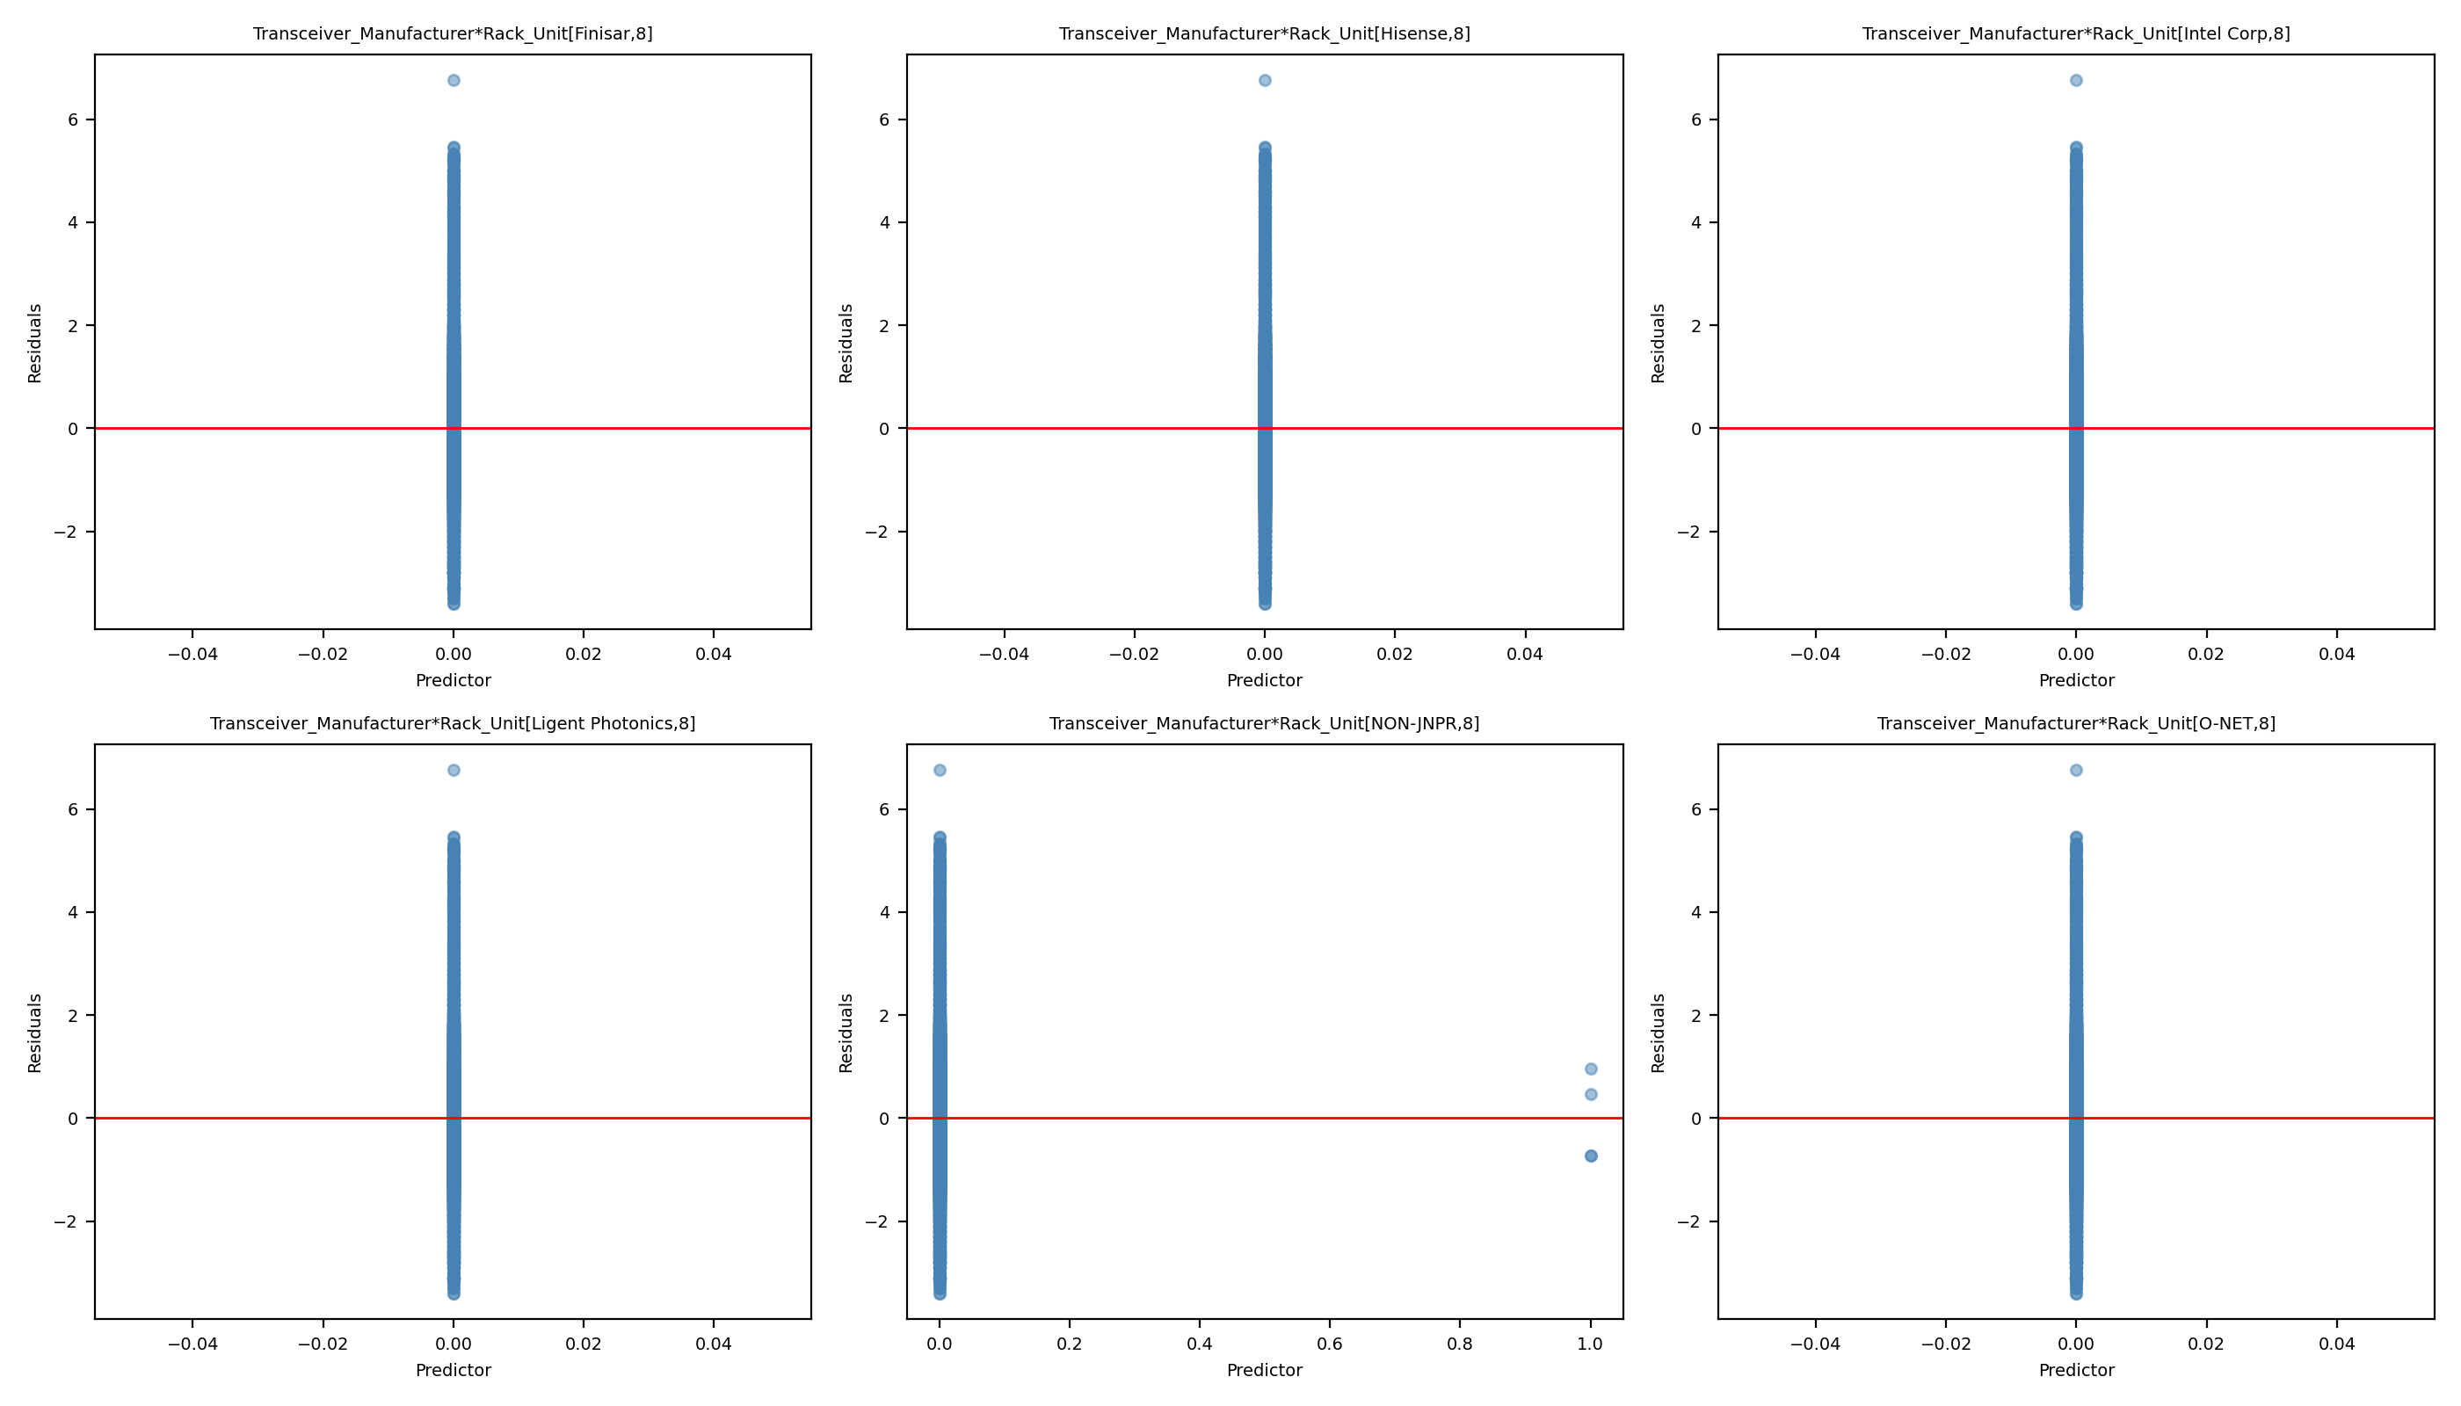
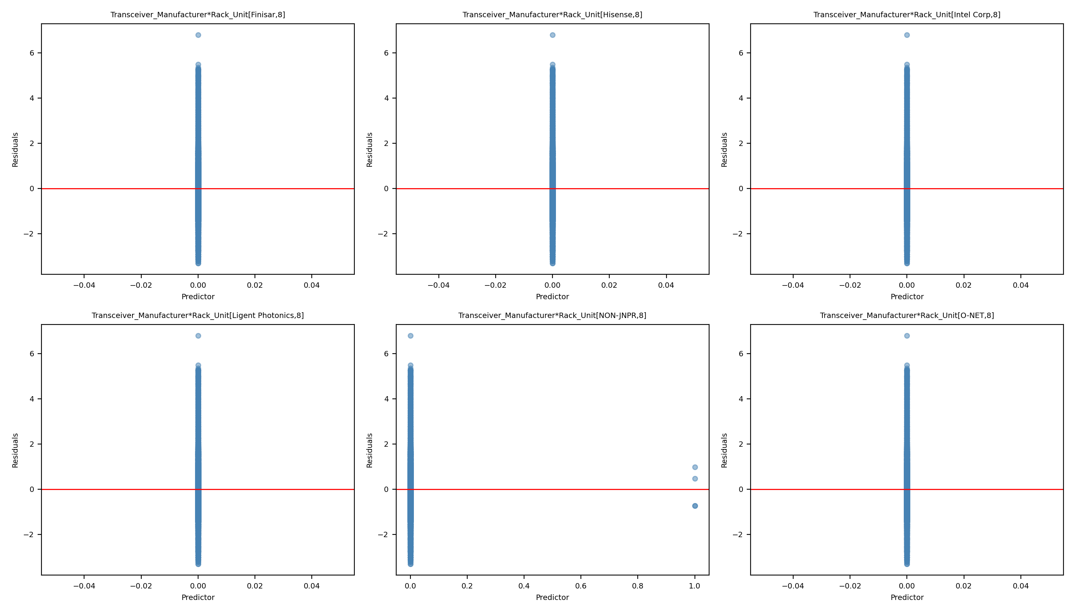
Leverage Comparison 18: Full Model vs Reduced Model
Full Model
Reduced Model

Slide 44
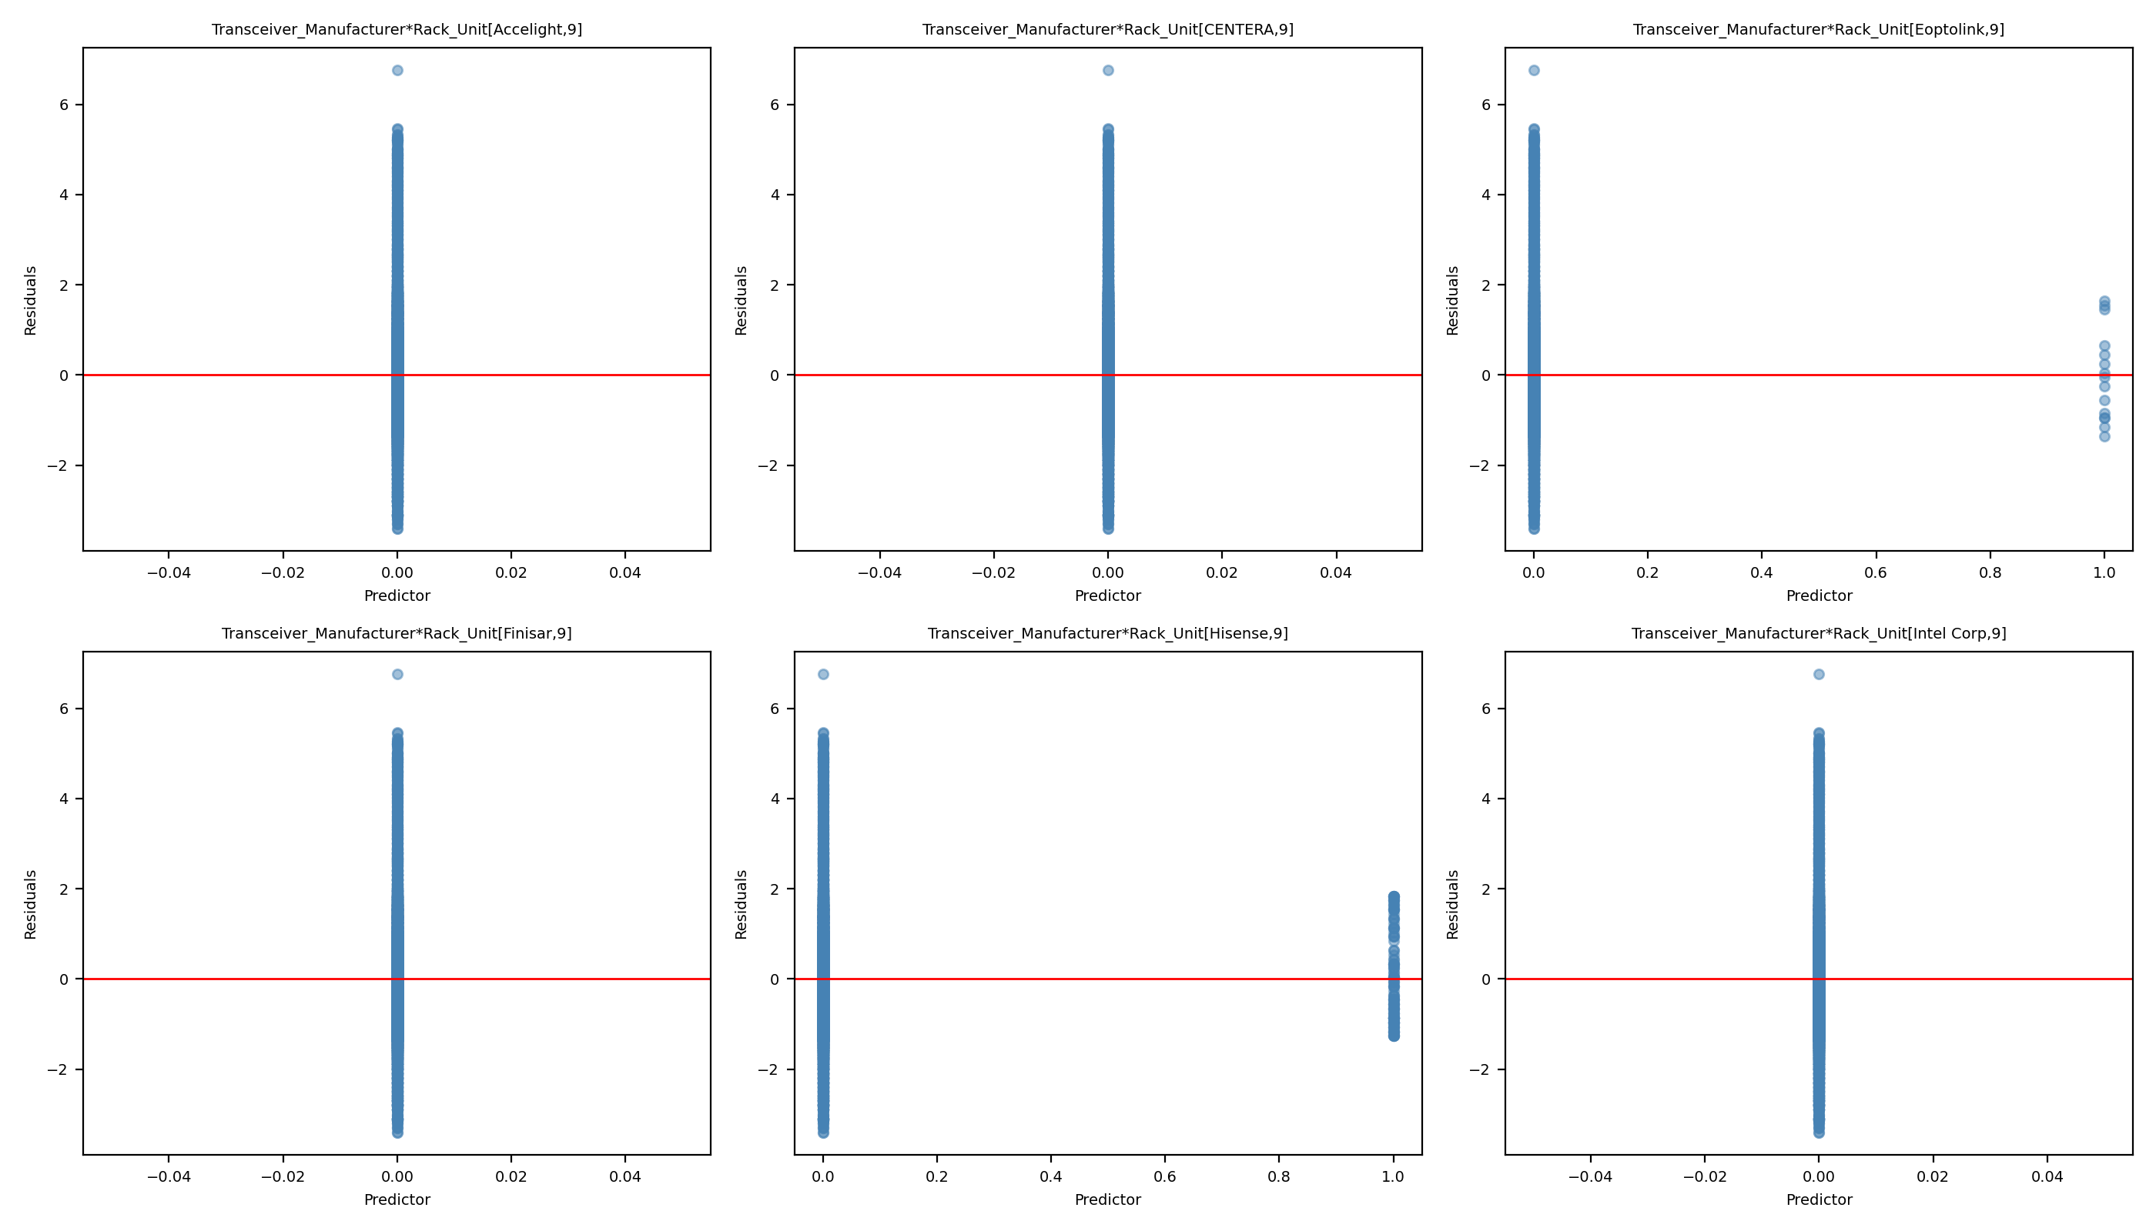
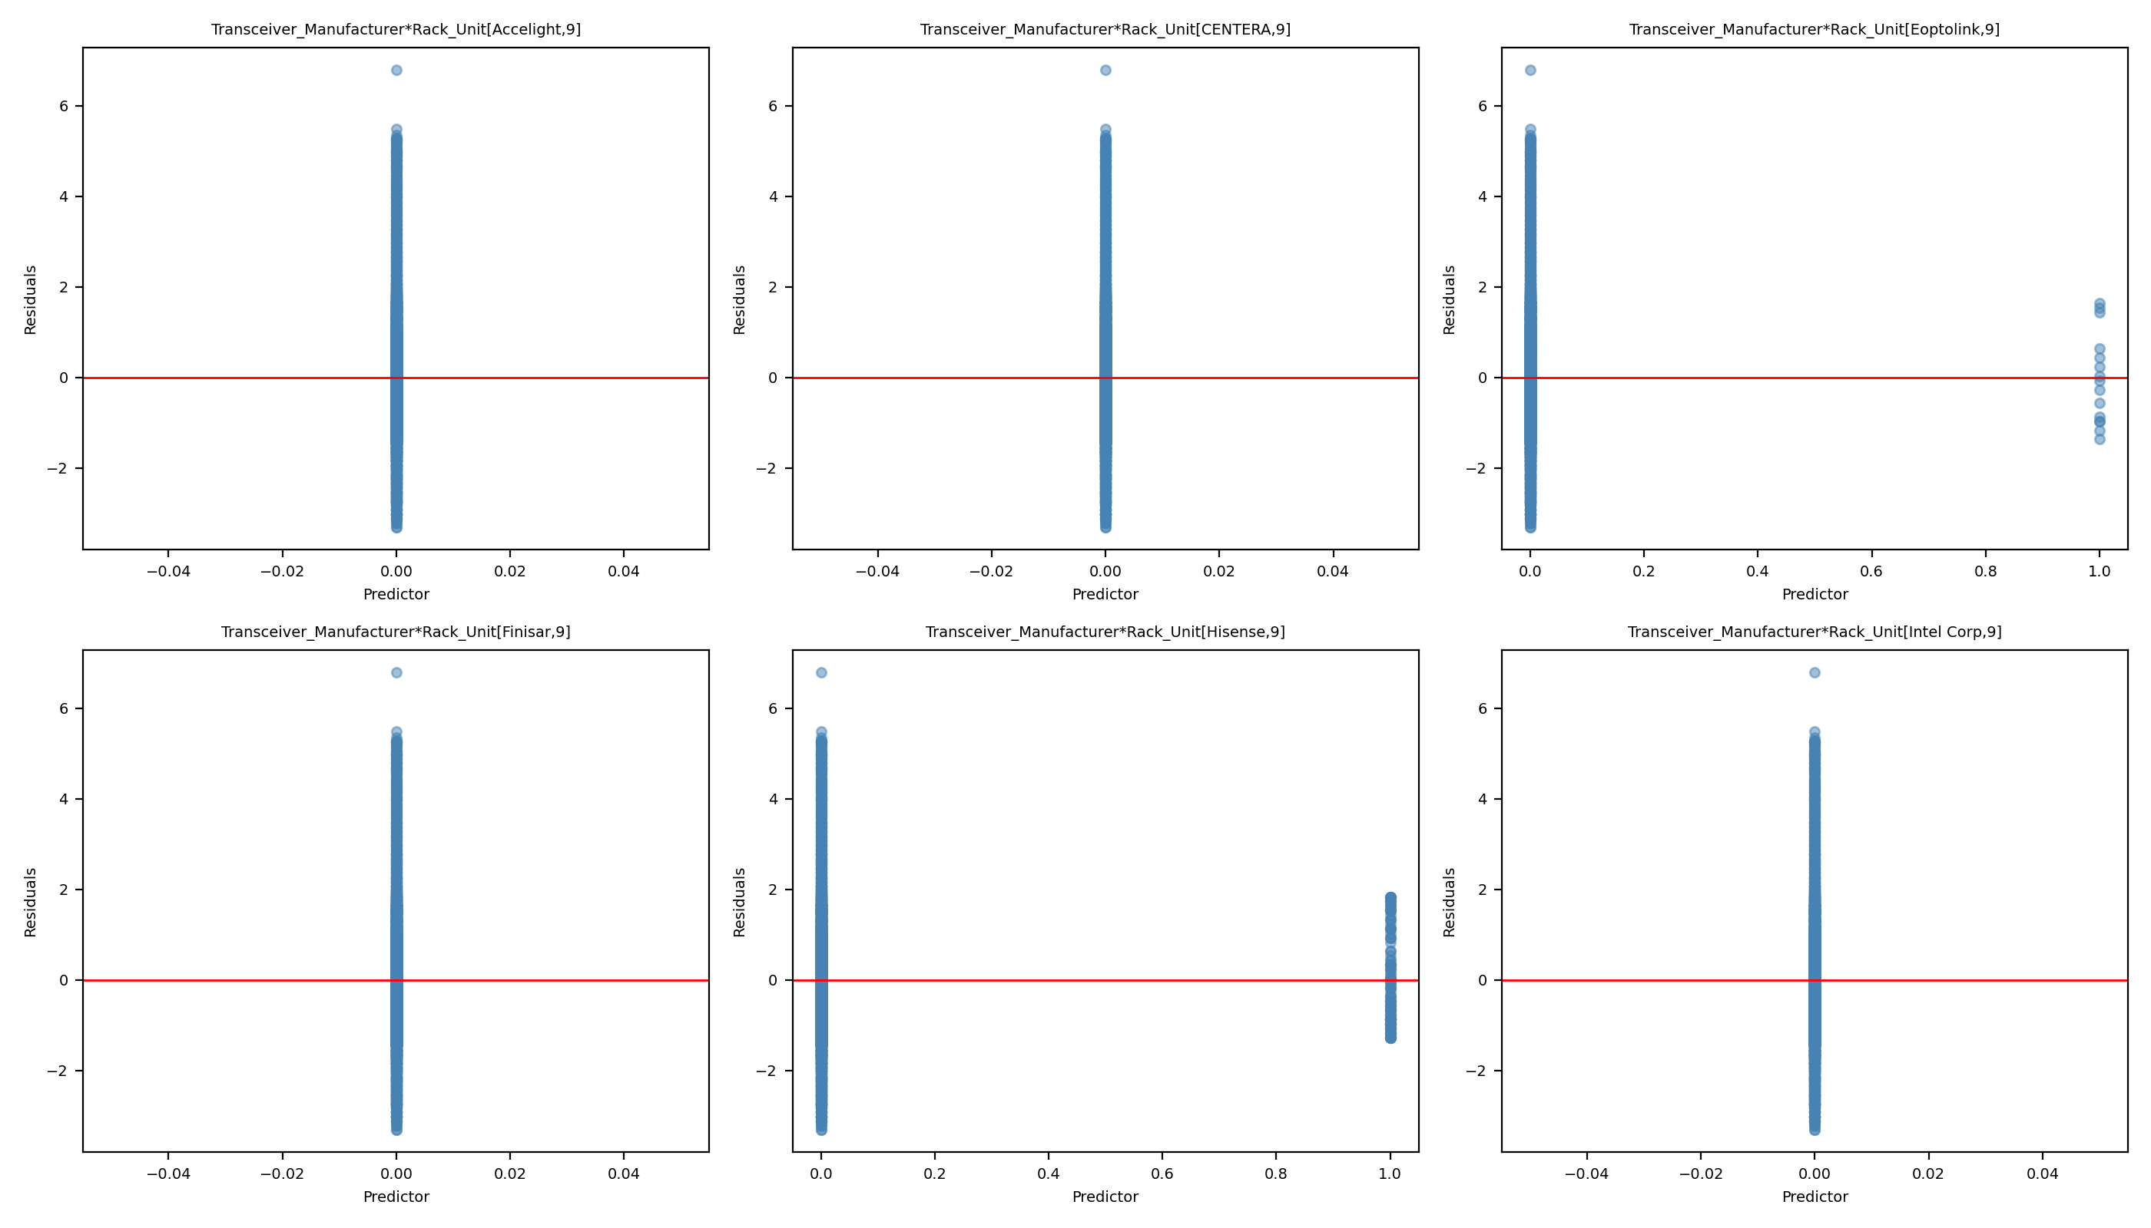
Leverage Comparison 19: Full Model vs Reduced Model
Full Model
Reduced Model

Slide 45
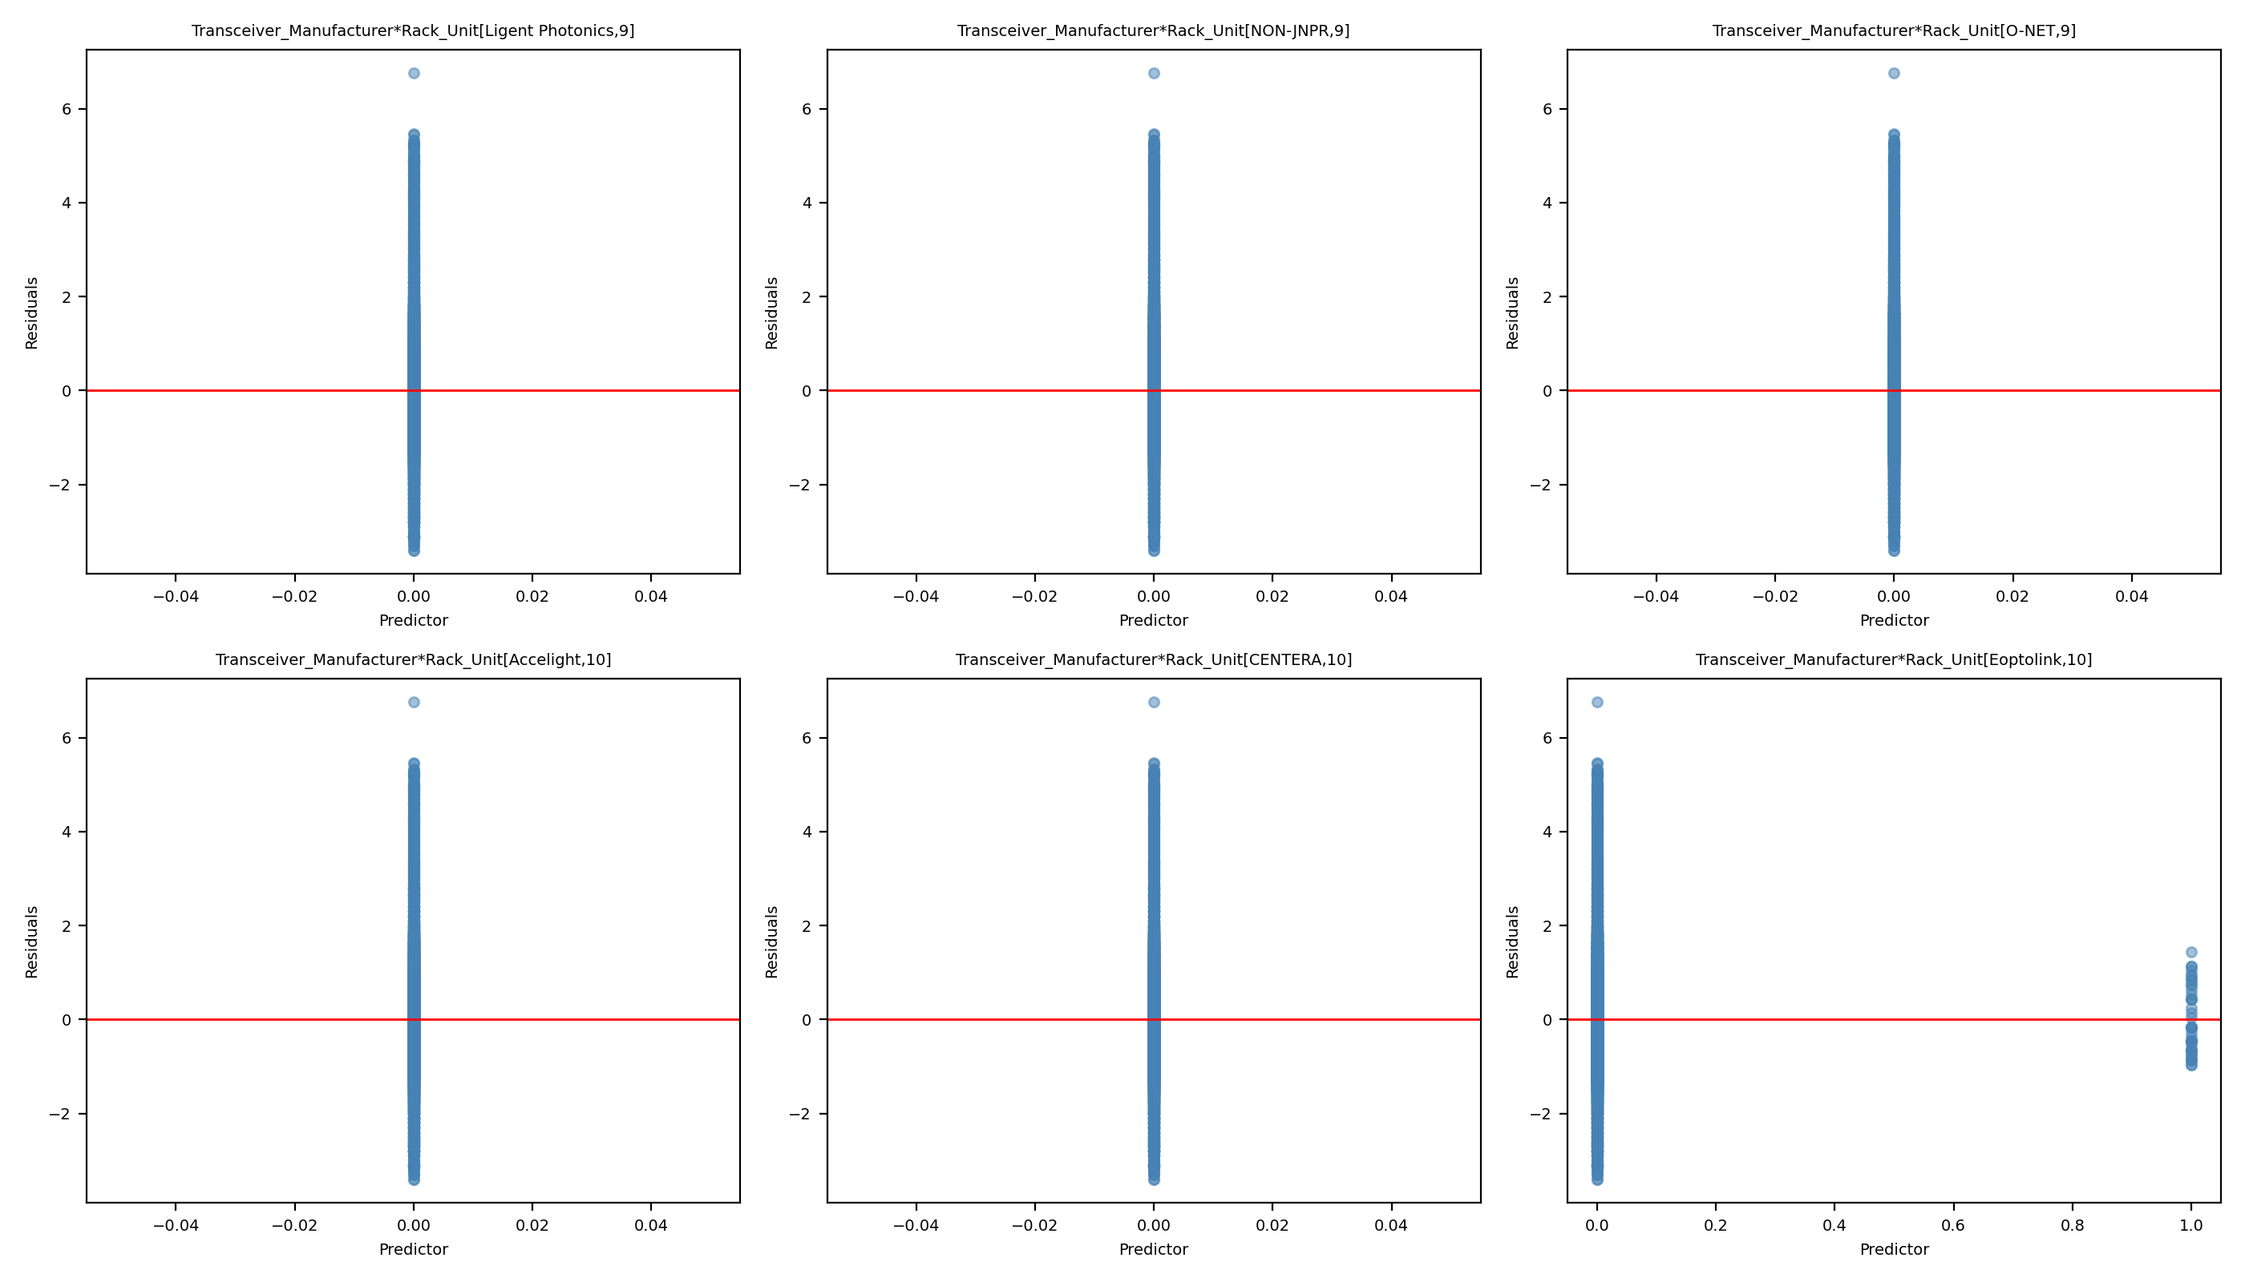
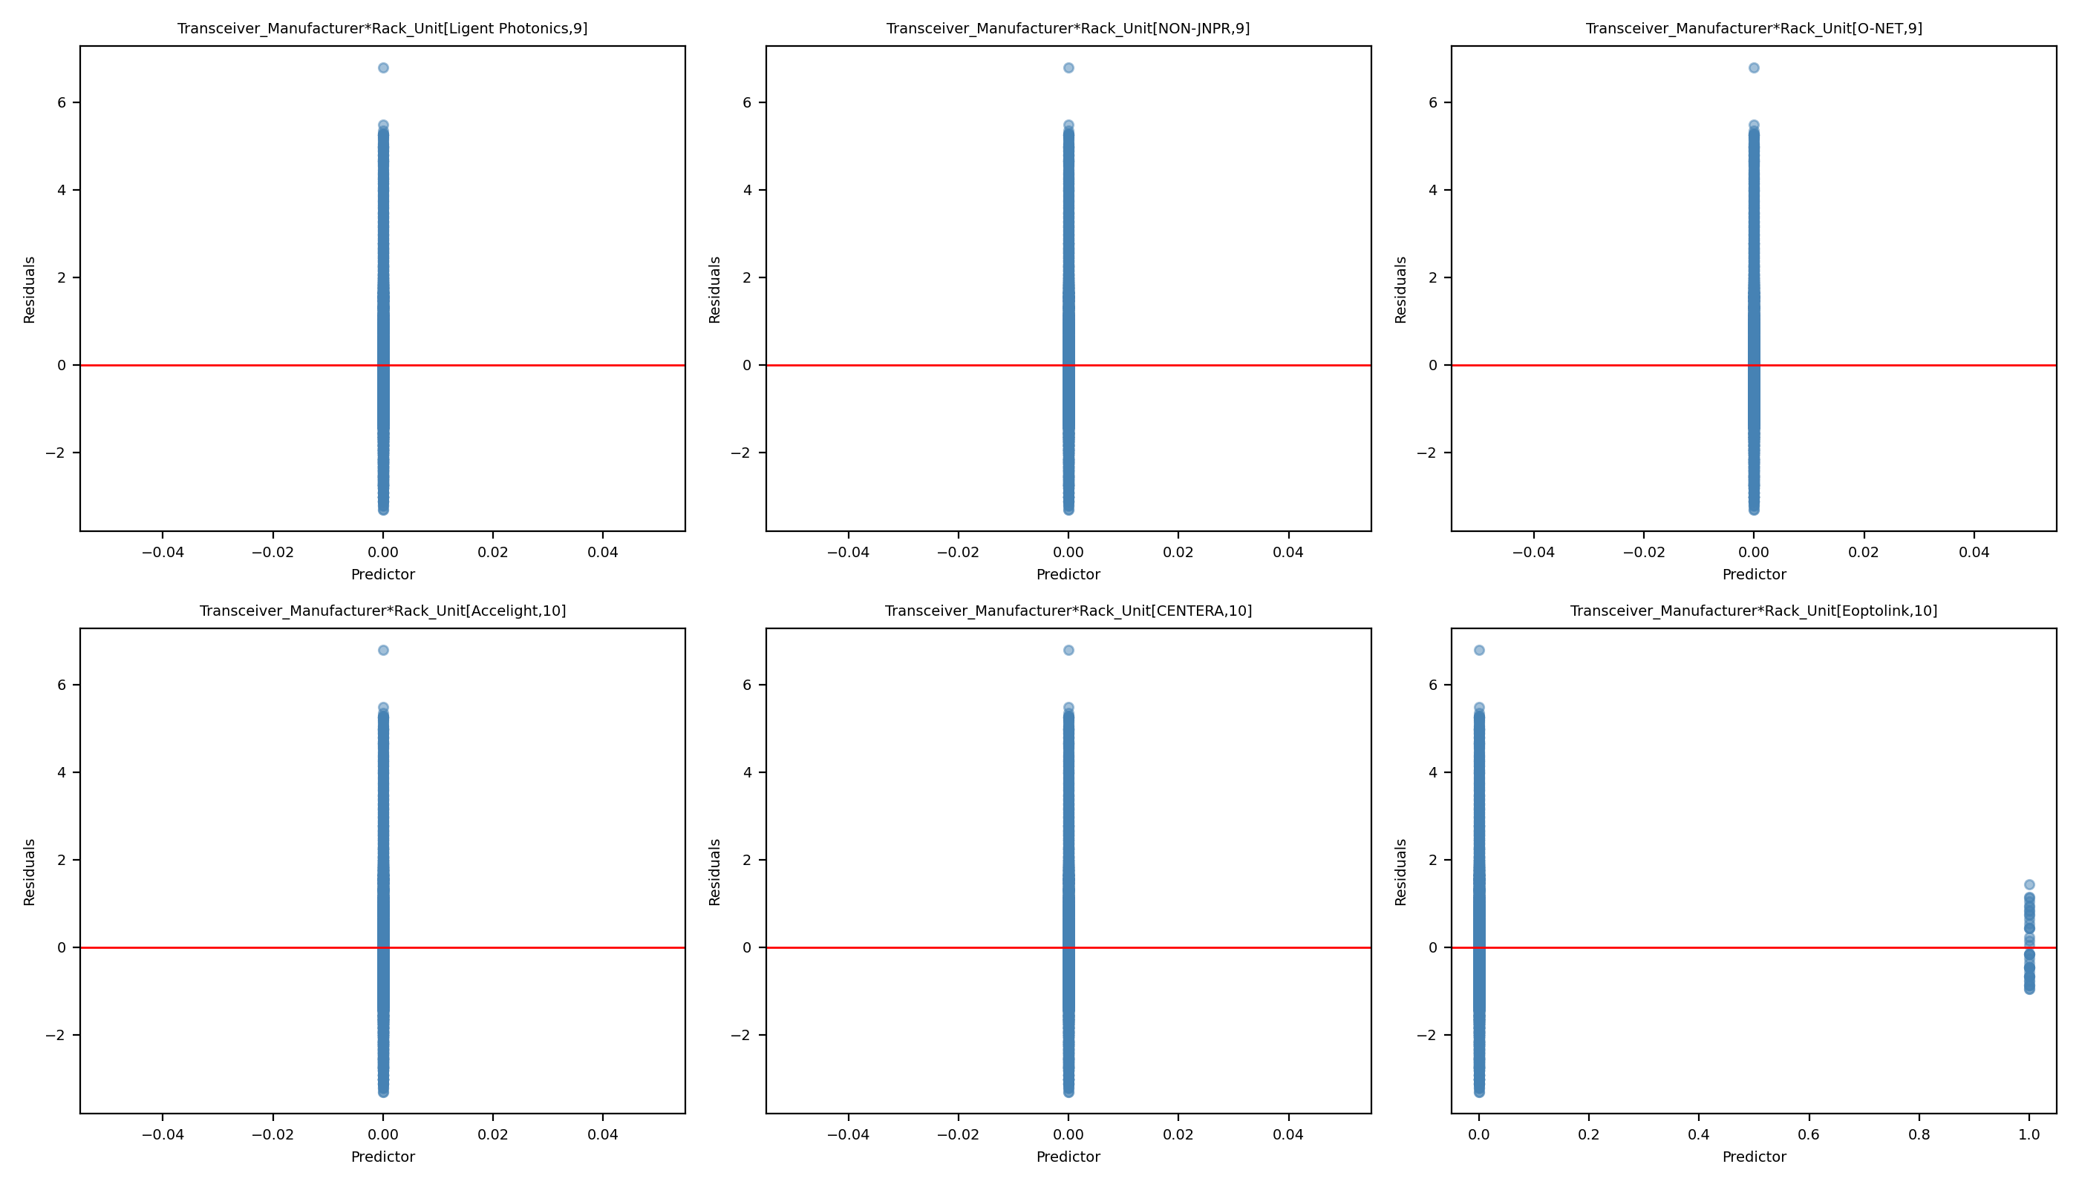
Leverage Comparison 20: Full Model vs Reduced Model
Full Model
Reduced Model

Slide 46
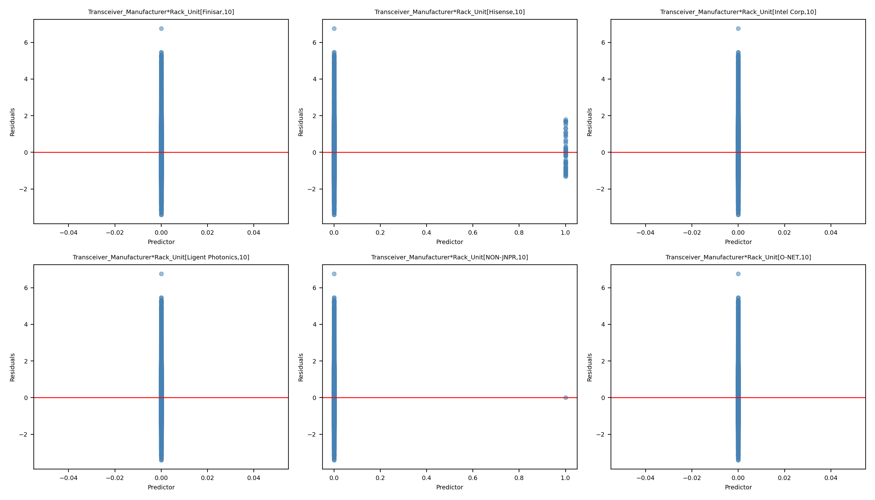
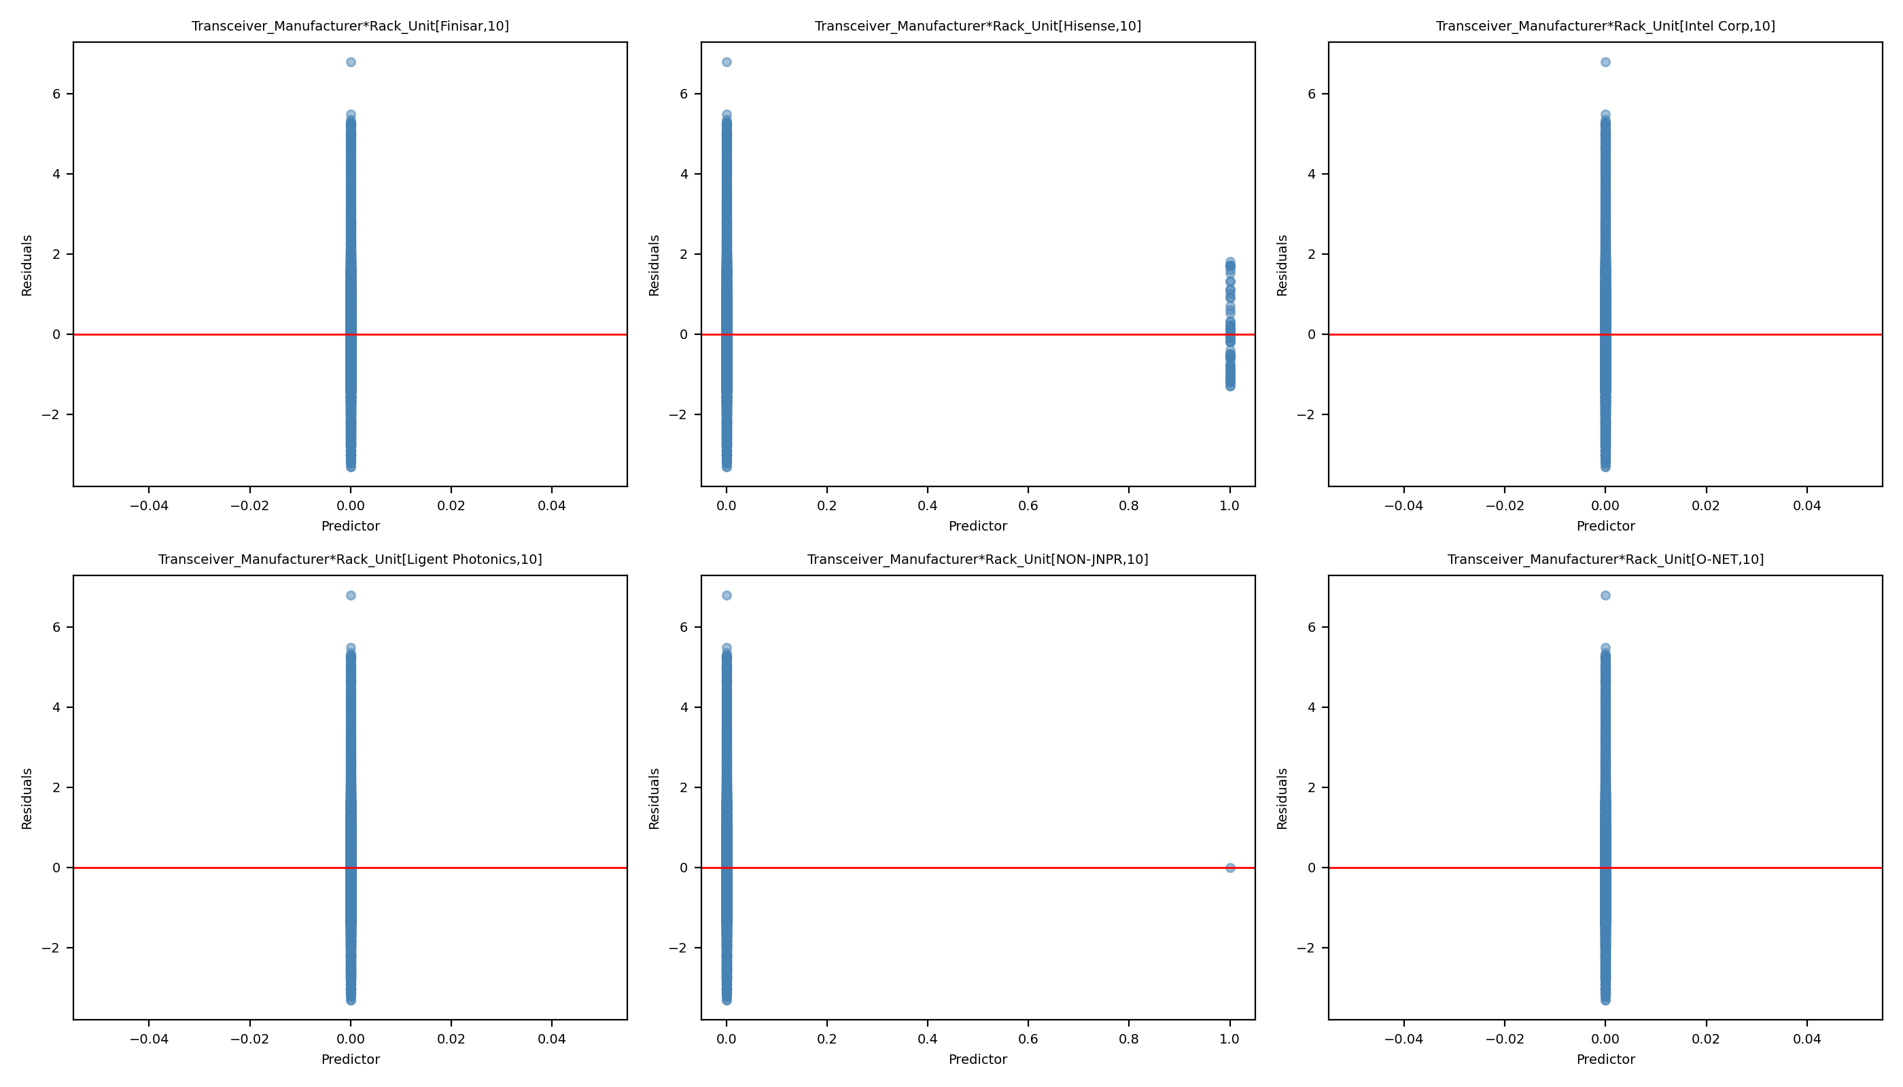
Leverage Comparison 21: Full Model vs Reduced Model
Full Model
Reduced Model

Slide 47
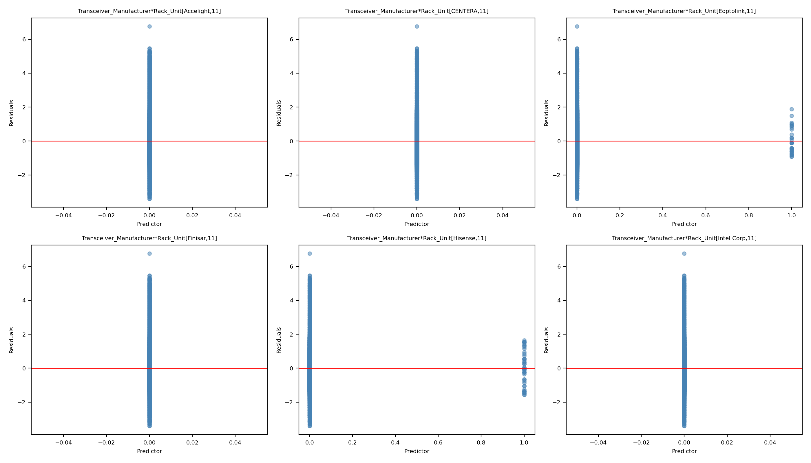
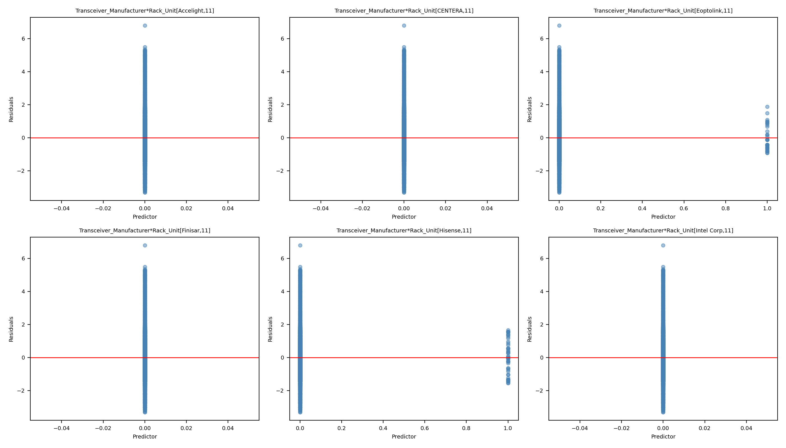
Leverage Comparison 22: Full Model vs Reduced Model
Full Model
Reduced Model

Slide 48
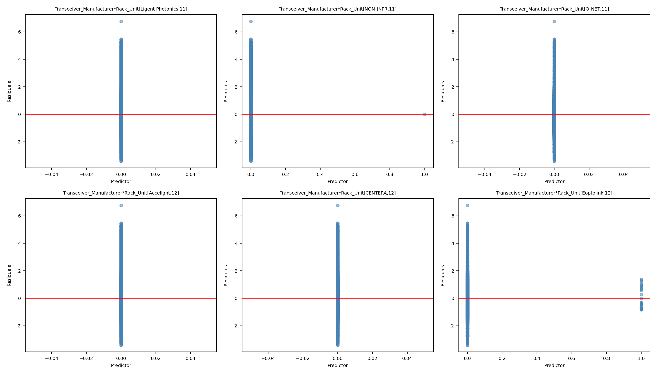
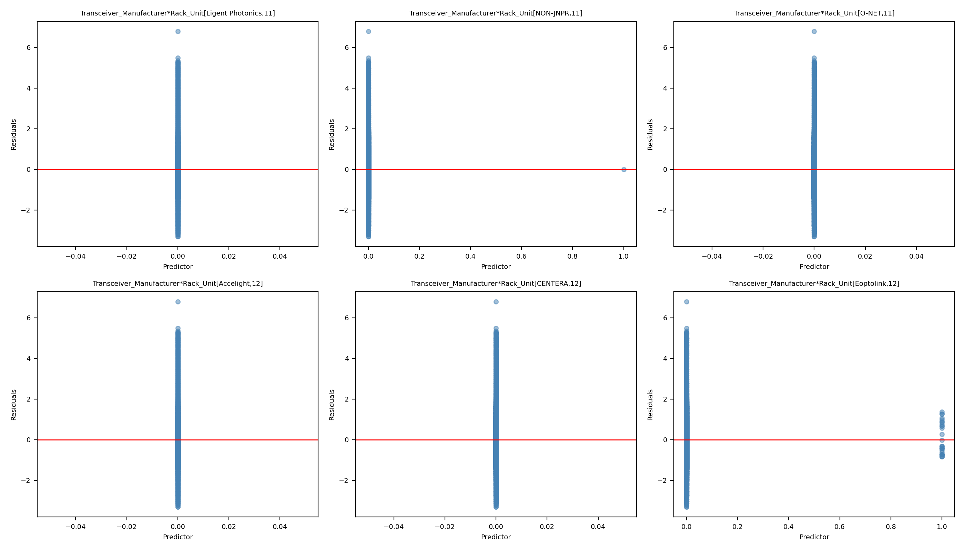
Leverage Comparison 23: Full Model vs Reduced Model
Full Model
Reduced Model

Slide 49
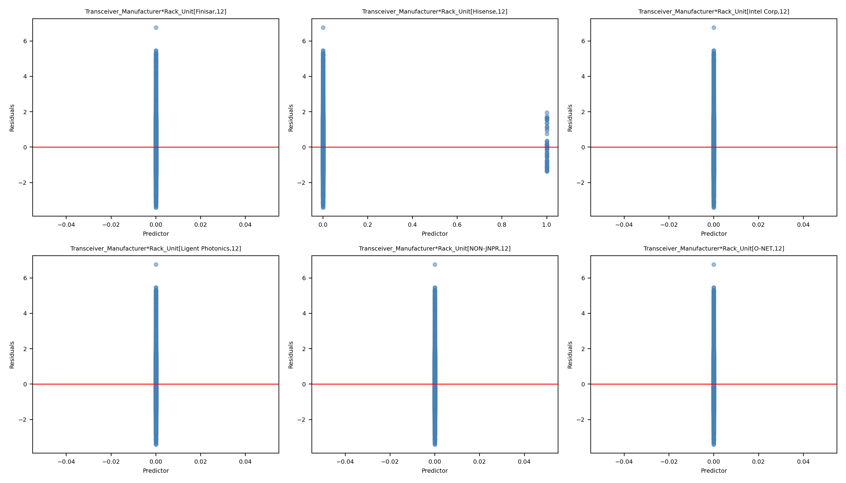
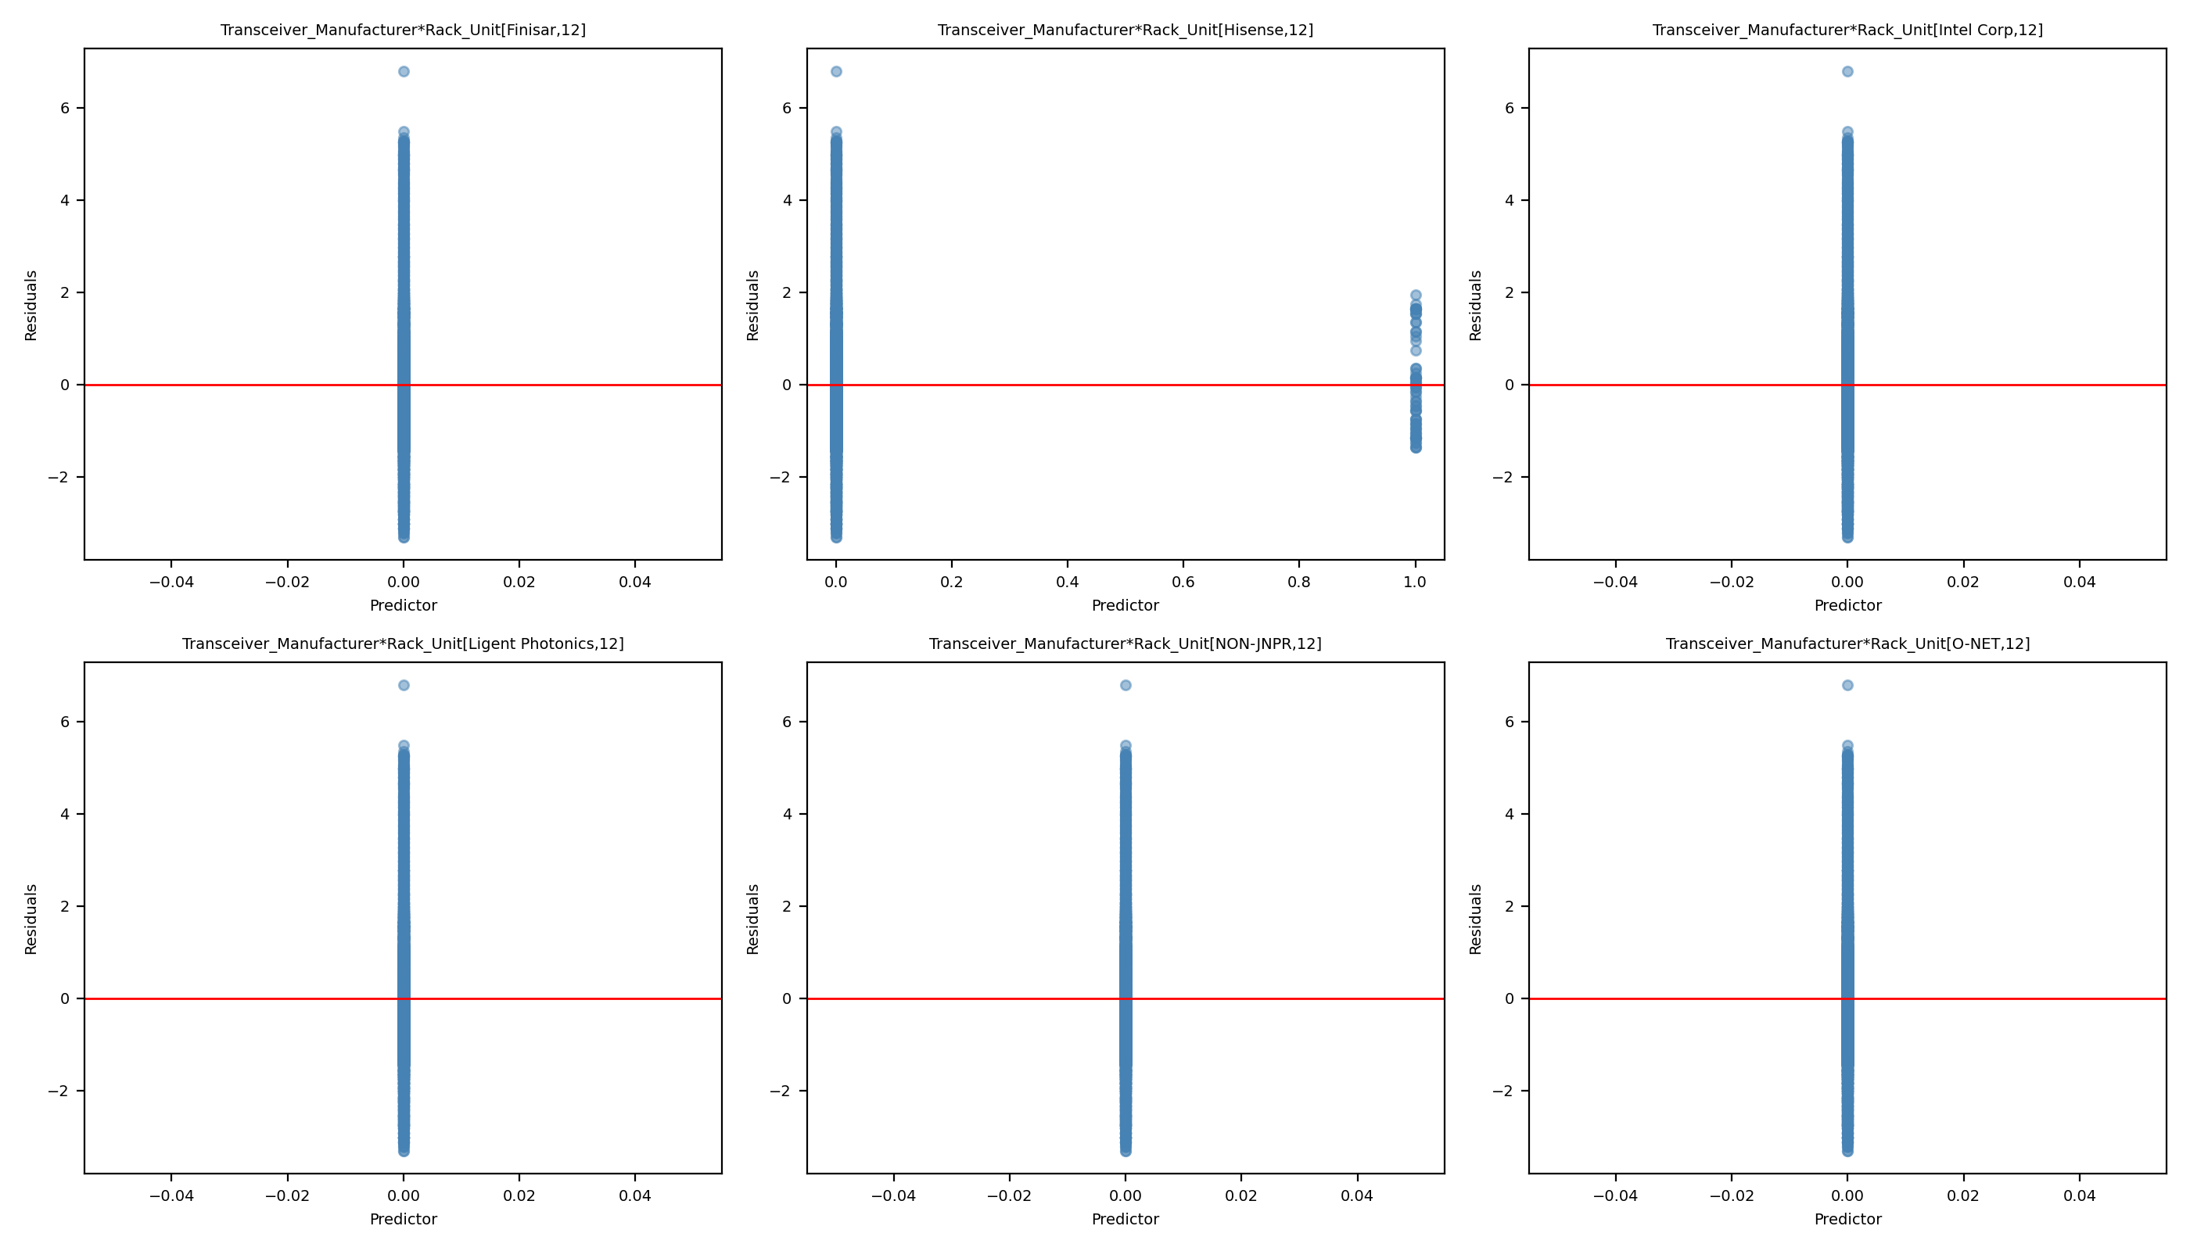
Leverage Comparison 24: Full Model vs Reduced Model
Full Model
Reduced Model

Slide 50
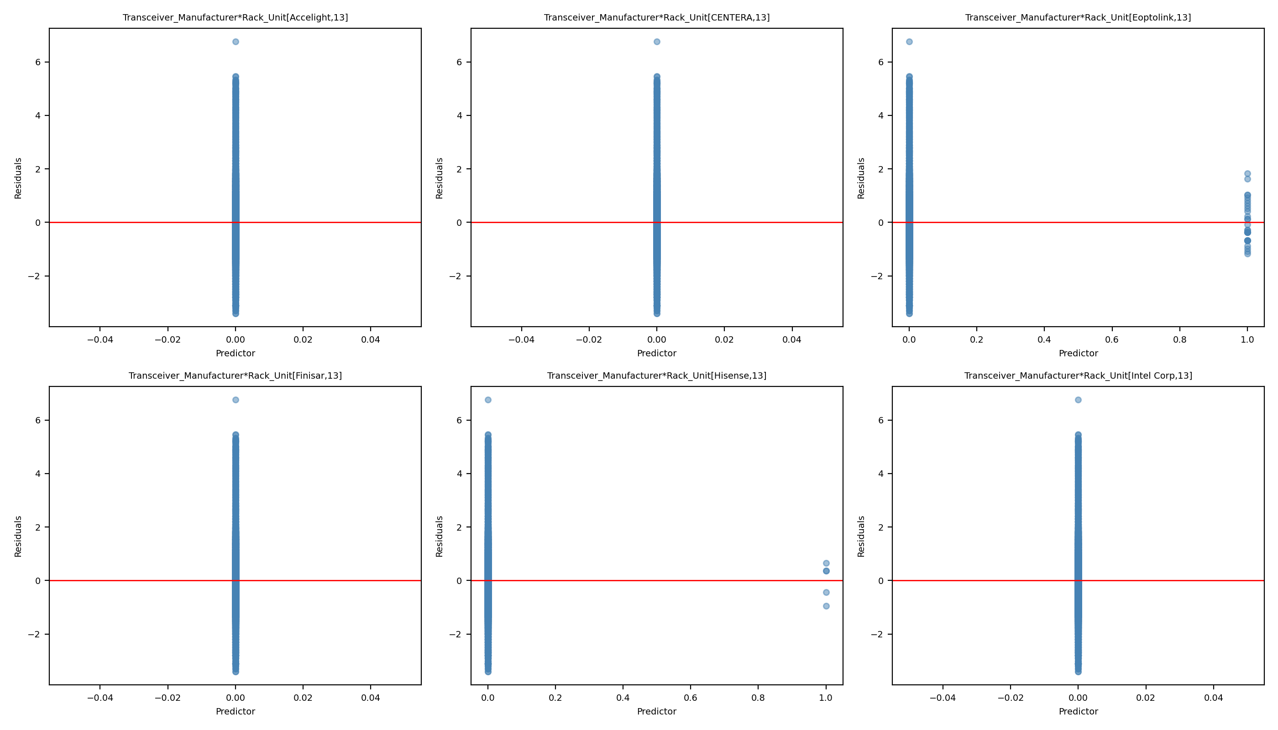
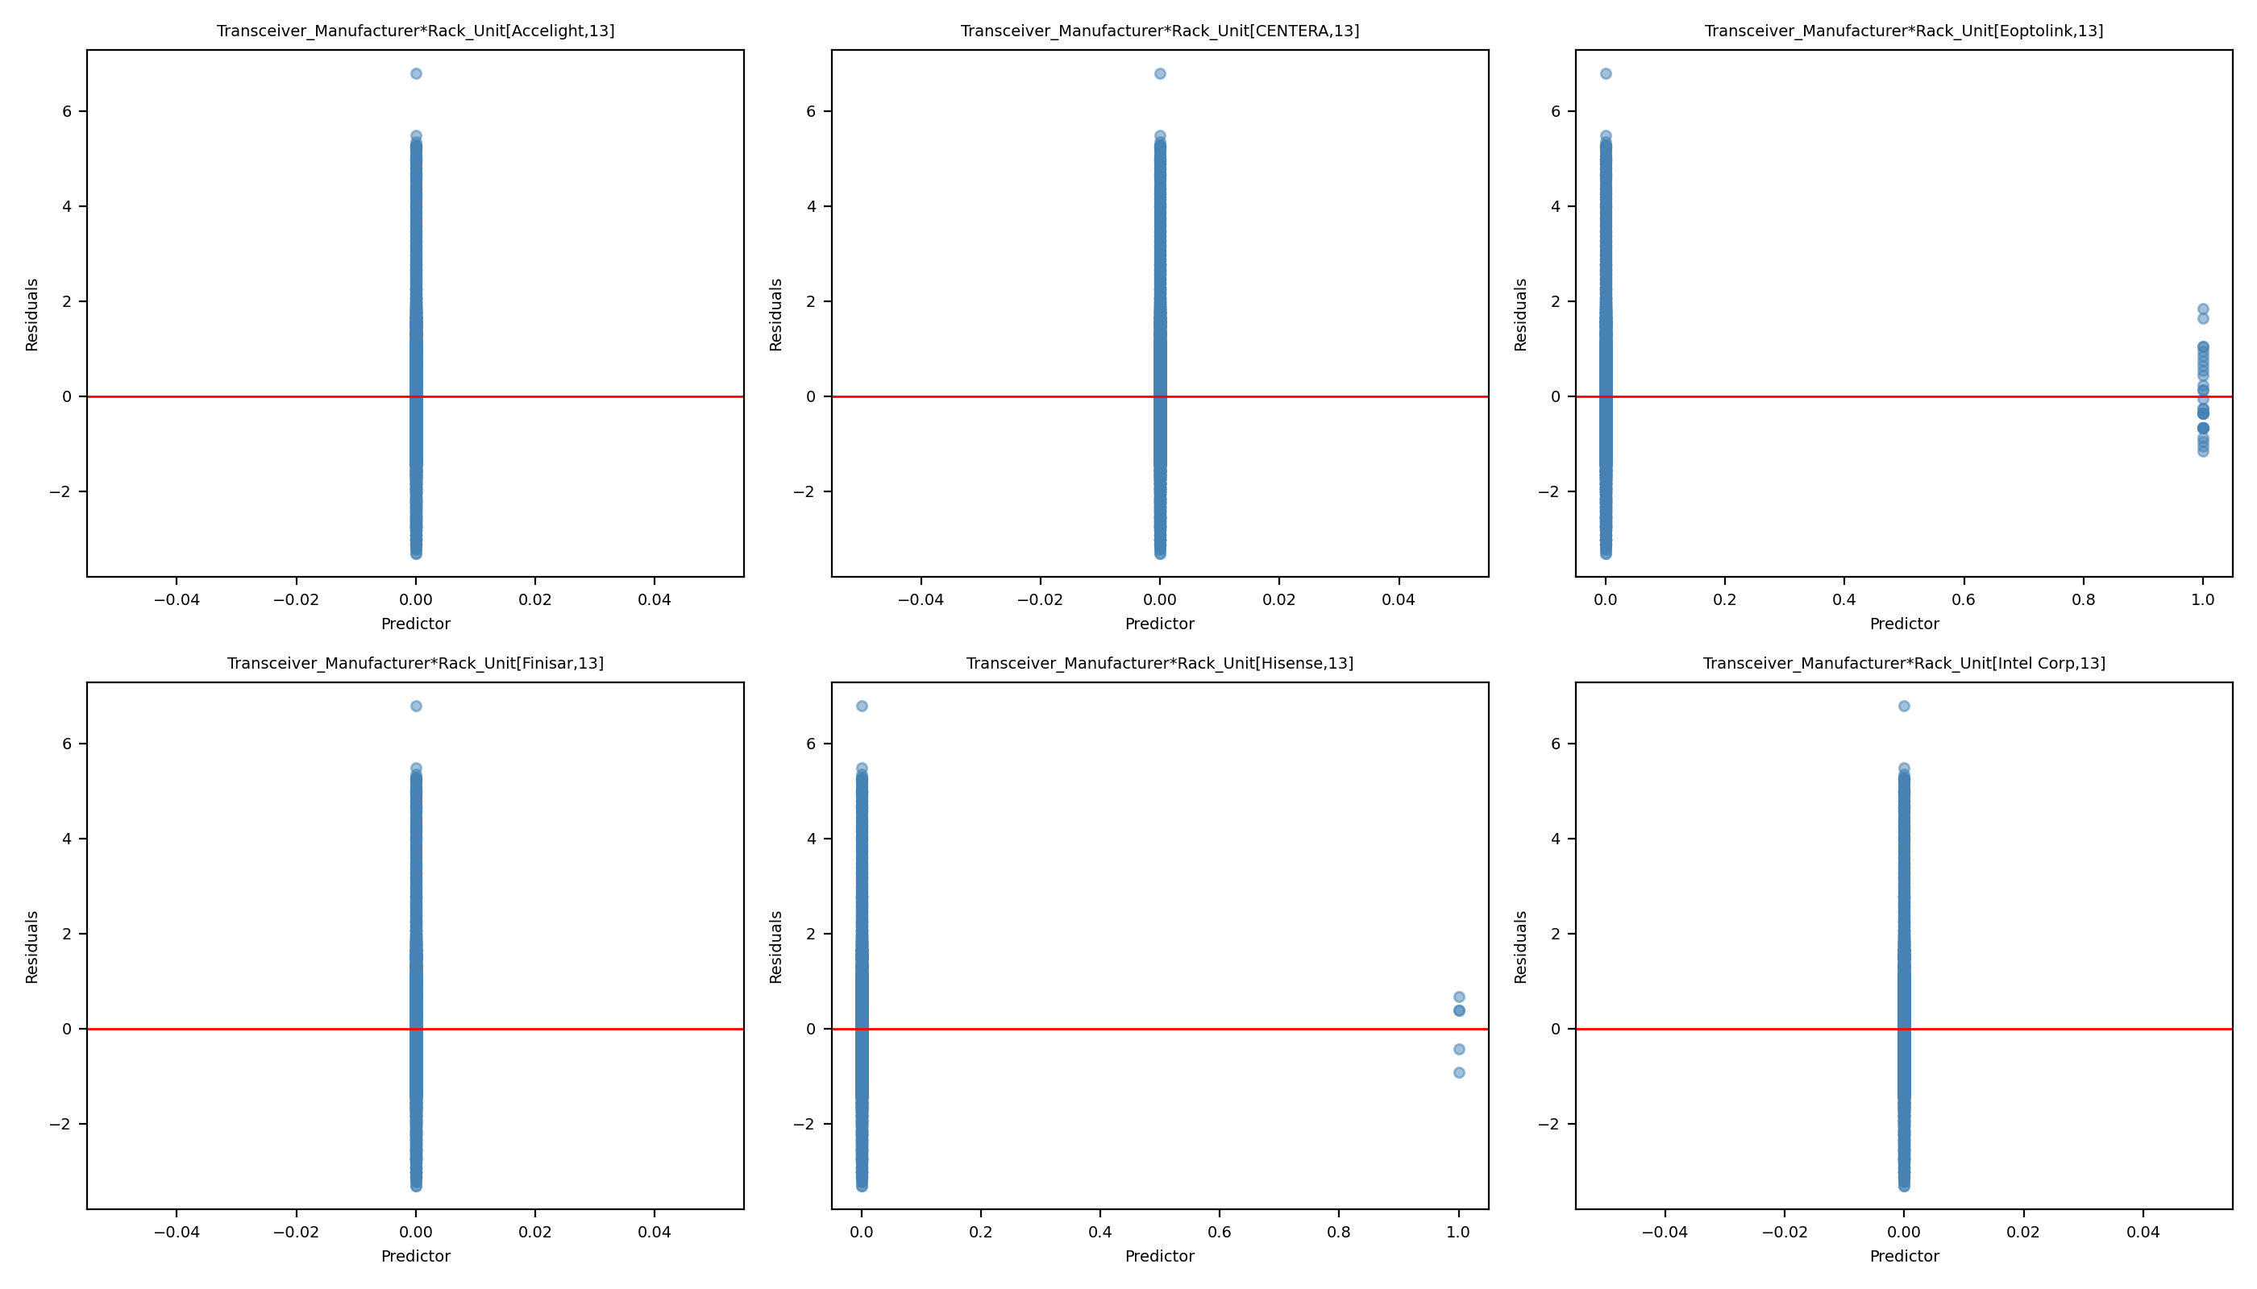
Leverage Comparison 25: Full Model vs Reduced Model
Full Model
Reduced Model

Slide 51


Leverage Comparison 26: Full Model vs Reduced Model
Full Model
Reduced Model

Slide 52
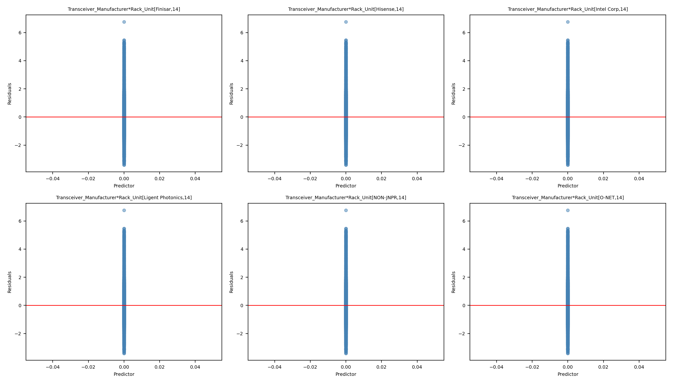
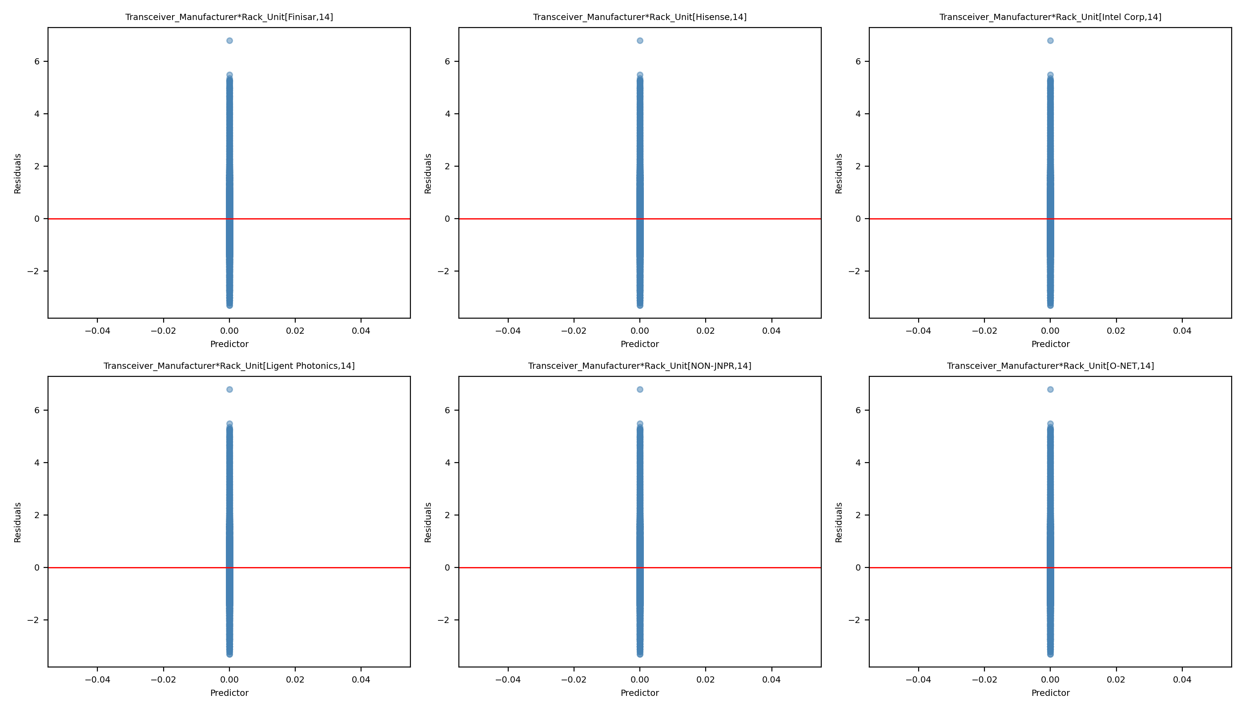
Leverage Comparison 27: Full Model vs Reduced Model
Full Model
Reduced Model

Slide 53


Leverage Comparison 28: Full Model vs Reduced Model
Full Model
Reduced Model

Slide 54


Leverage Comparison 29: Full Model vs Reduced Model
Full Model
Reduced Model

Slide 55


Leverage Comparison 30: Full Model vs Reduced Model
Full Model
Reduced Model

Slide 56


Leverage Comparison 31: Full Model vs Reduced Model
Full Model
Reduced Model

Slide 57


Leverage Comparison 32: Full Model vs Reduced Model
Full Model
Reduced Model

Slide 58


Leverage Comparison 33: Full Model vs Reduced Model
Full Model
Reduced Model

Slide 59


Leverage Comparison 34: Full Model vs Reduced Model
Full Model
Reduced Model

Slide 60


Leverage Comparison 35: Full Model vs Reduced Model
Full Model
Reduced Model

Slide 61


Leverage Comparison 36: Full Model vs Reduced Model
Full Model
Reduced Model

Slide 62


Leverage Comparison 37: Full Model vs Reduced Model
Full Model
Reduced Model

Slide 63


Leverage Comparison 38: Full Model vs Reduced Model
Full Model
Reduced Model

Slide 64


Leverage Comparison 39: Full Model vs Reduced Model
Full Model
Reduced Model

Slide 65


Leverage Comparison 40: Full Model vs Reduced Model
Full Model
Reduced Model

Slide 66


Leverage Comparison 41: Full Model vs Reduced Model
Full Model
Reduced Model

Slide 67


Leverage Comparison 42: Full Model vs Reduced Model
Full Model
Reduced Model

Slide 68


Leverage Comparison 43: Full Model vs Reduced Model
Full Model
Reduced Model

Slide 69


Leverage Comparison 44: Full Model vs Reduced Model
Full Model
Reduced Model

Slide 70


Leverage Comparison 45: Full Model vs Reduced Model
Full Model
Reduced Model

Slide 71


Leverage Comparison 46: Full Model vs Reduced Model
Full Model
Reduced Model

Slide 72


Leverage Comparison 47: Full Model vs Reduced Model
Full Model
Reduced Model

Slide 73


Leverage Comparison 48: Full Model vs Reduced Model
Full Model
Reduced Model

Slide 74


Leverage Comparison 49: Full Model vs Reduced Model
Full Model
Reduced Model

Slide 75


Leverage Comparison 50: Full Model vs Reduced Model
Full Model
Reduced Model

Slide 76


Leverage Comparison 51: Full Model vs Reduced Model
Full Model
Reduced Model

Slide 77


Leverage Comparison 52: Full Model vs Reduced Model
Full Model
Reduced Model

Slide 78


Leverage Comparison 53: Full Model vs Reduced Model
Full Model
Reduced Model

Slide 79


Leverage Comparison 54: Full Model vs Reduced Model
Full Model
Reduced Model

Slide 80


Leverage Comparison 55: Full Model vs Reduced Model
Full Model
Reduced Model

Slide 81


Leverage Comparison 56: Full Model vs Reduced Model
Full Model
Reduced Model

Slide 82


Leverage Comparison 57: Full Model vs Reduced Model
Full Model
Reduced Model

Slide 83


Leverage Comparison 58: Full Model vs Reduced Model
Full Model
Reduced Model

Slide 84


Leverage Comparison 59: Full Model vs Reduced Model
Full Model
Reduced Model

Slide 85


Leverage Comparison 60: Full Model vs Reduced Model
Full Model
Reduced Model

Slide 86


Leverage Comparison 61: Full Model vs Reduced Model
Full Model
Reduced Model

Slide 87


Leverage Comparison 62: Full Model vs Reduced Model
Full Model
Reduced Model

Slide 88


Leverage Comparison 63: Full Model vs Reduced Model
Full Model
Reduced Model

Slide 89


Leverage Comparison 64: Full Model vs Reduced Model
Full Model
Reduced Model

Slide 90


Leverage Comparison 65: Full Model vs Reduced Model
Full Model
Reduced Model

Slide 91


Leverage Comparison 66: Full Model vs Reduced Model
Full Model
Reduced Model

Slide 92


Leverage Comparison 67: Full Model vs Reduced Model
Full Model
Reduced Model

Slide 93


Leverage Comparison 68: Full Model vs Reduced Model
Full Model
Reduced Model

Slide 94


Leverage Comparison 69: Full Model vs Reduced Model
Full Model
Reduced Model

Slide 95


Leverage Comparison 70: Full Model vs Reduced Model
Full Model
Reduced Model

Slide 96


Leverage Comparison 71: Full Model vs Reduced Model
Full Model
Reduced Model

Slide 97


Leverage Comparison 72: Full Model vs Reduced Model
Full Model
Reduced Model

Slide 98


Leverage Comparison 73: Full Model vs Reduced Model
Full Model
Reduced Model

Slide 99


Leverage Comparison 74: Full Model vs Reduced Model
Full Model
Reduced Model

Slide 100


Leverage Comparison 75: Full Model vs Reduced Model
Full Model
Reduced Model

